Slide 1

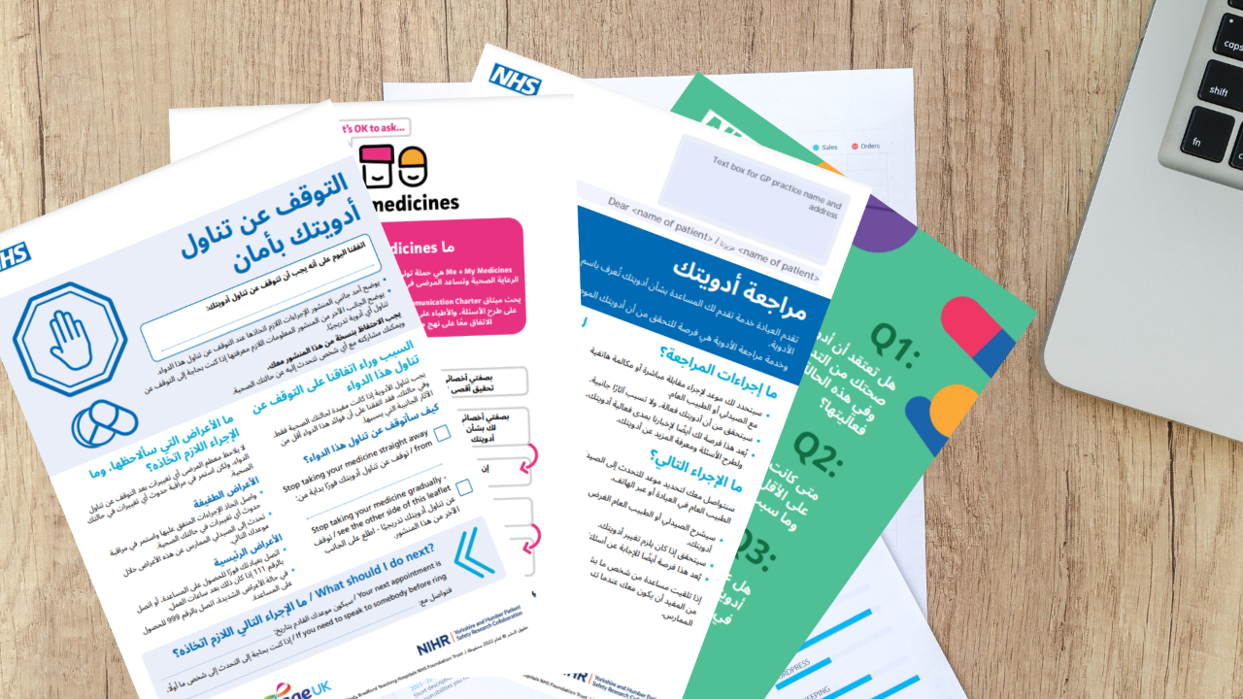

The Health Innovation Network have produced various resources in Arabic to support patients having a Structured Medication Review.
Standard versions:
Patient invitation letter
Safely stopping your medicine leaflet
Me and My Medicines Charter
Are Your Medicines Working? patient checklist
Are Your Medicines Working? symptom tracker
Easy read versions:
Patient invitation letter – easy read
Safely stopping your medicine leaflet – easy read
Me and My Medicines Charter – easy read
A new animation has also been created to help patients think about their medicines and to prepare for a Structured Medication Review which you can view here.

Slide 2
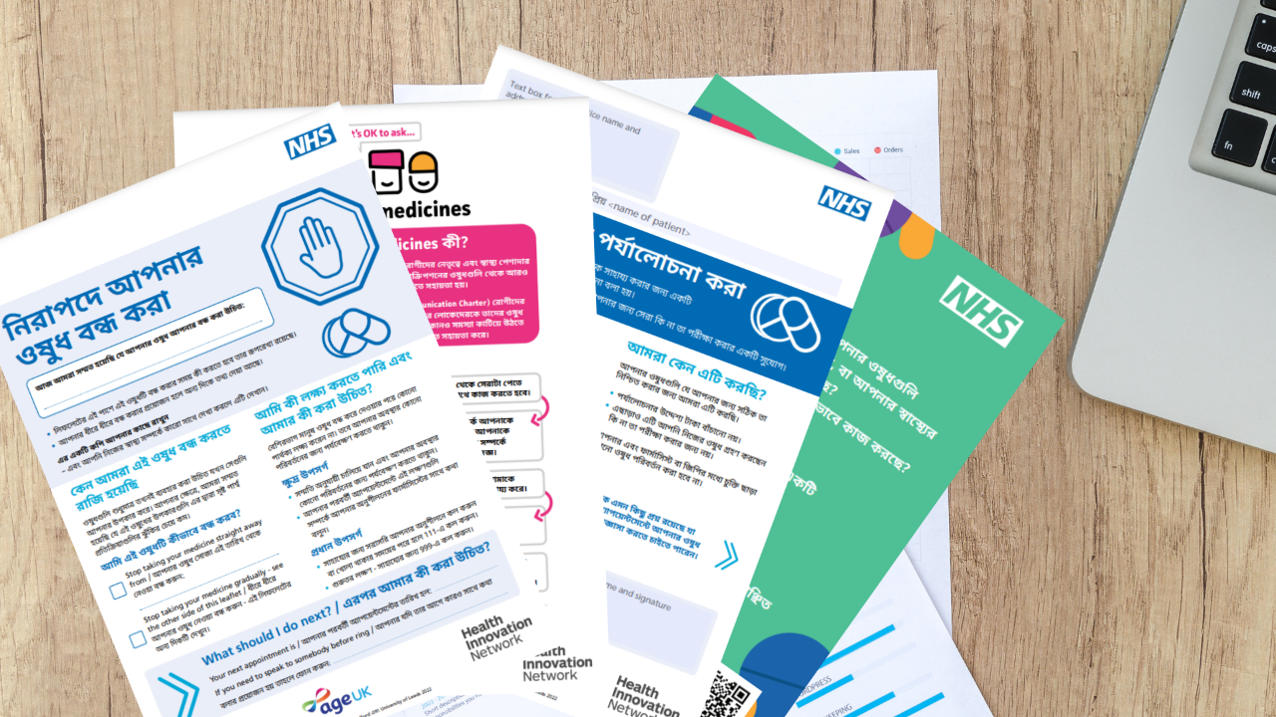
The Health Innovation Network have produced various resources in Bengali to support patients having a Structured Medication Review.
Standard versions:
Patient invitation letter
Safely stopping your medicine leaflet
Me and My Medicines Charter
Are Your Medicines Working? patient checklist
Are Your Medicines Working? symptom tracker
Easy read versions:
Patient invitation letter – easy read
Safely stopping your medicine leaflet – easy read
Me and My Medicines Charter – easy read
A new animation has also been created to help patients think about their medicines and to prepare for a Structured Medication Review which you can view here.

Slide 3
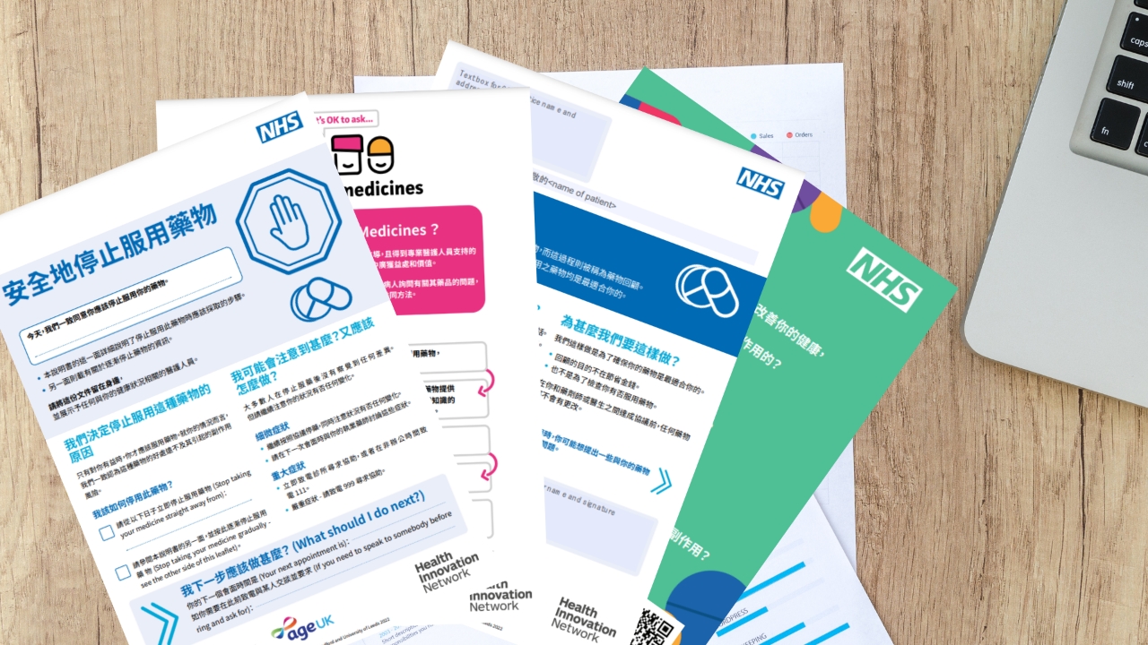
The Health Innovation Network have produced various resources in Cantonese to support patients having a Structured Medication Review.
Standard versions:
Patient invitation letter
Safely stopping your medicine leaflet
Me and My Medicines Charter
Are Your Medicines Working? patient checklist
Are Your Medicines Working? symptom tracker
Easy read versions:
Patient invitation letter – easy read
Safely stopping your medicine leaflet – easy read
Me and My Medicines Charter – easy read
A new animation has also been created to help patients think about their medicines and to prepare for a Structured Medication Review which you can view here.

Slide 4
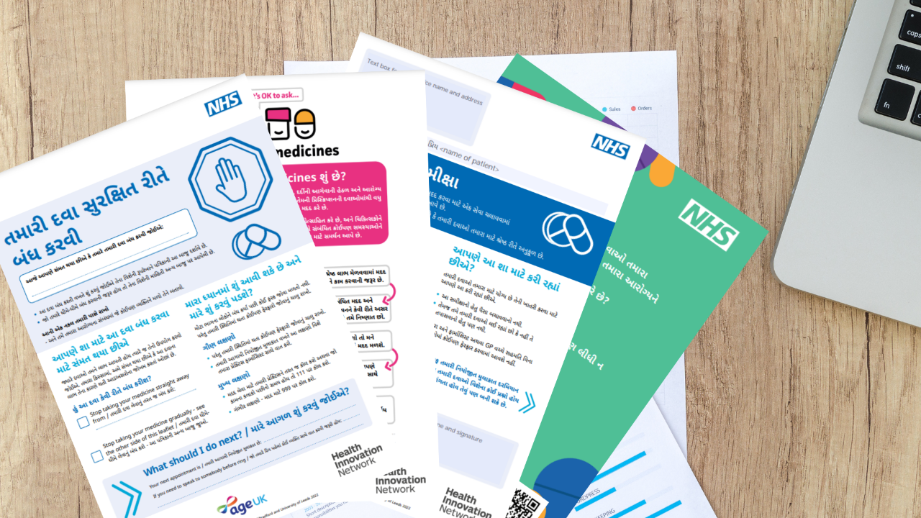
The Health Innovation Network have produced various resources in Gujarati to support patients having a Structured Medication Review.
Standard versions:
Patient invitation letter
Safely stopping your medicine leaflet
Me and My Medicines Charter
Are Your Medicines Working? patient checklist
Are Your Medicines Working? symptom tracker
Easy read versions:
Patient invitation letter – easy read
Safely stopping your medicine leaflet – easy read
Me and My Medicines Charter – easy read
A new animation has also been created to help patients think about their medicines and to prepare for a Structured Medication Review which you can view here.

Slide 5
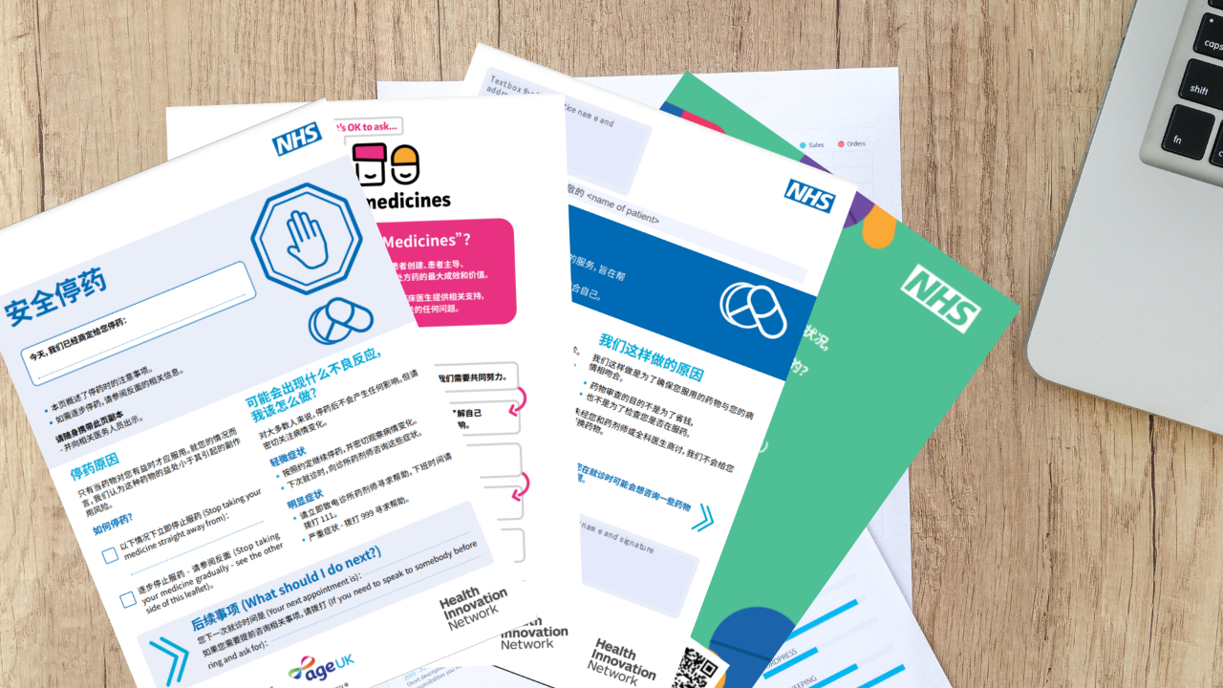
The Health Innovation Network have produced various resources in Mandarin to support patients having a Structured Medication Review.
Standard versions:
Patient invitation letter
Safely stopping your medicine leaflet
Me and My Medicines Charter
Are Your Medicines Working? patient checklist
Are Your Medicines Working? symptom tracker
Easy read versions:
Patient invitation letter – easy read
Safely stopping your medicine leaflet – easy read
Me and My Medicines Charter – easy read
A new animation has also been created to help patients think about their medicines and to prepare for a Structured Medication Review which you can view here.

Slide 6

The Health Innovation Network have produced various resources in Polish to support patients having a Structured Medication Review.
Standard versions:
Patient invitation letter
Safely stopping your medicine leaflet
Me and My Medicines Charter
Are Your Medicines Working? patient checklist
Are Your Medicines Working? symptom tracker
Easy read versions:
Patient invitation letter – easy read
Safely stopping your medicine leaflet – easy read
Me and My Medicines Charter – easy read
A new animation has also been created to help patients think about their medicines and to prepare for a Structured Medication Review which you can view here.

Slide 7

The Health Innovation Network have produced various resources in Punjabi Gurmukhi to support patients having a Structured Medication Review.
Standard versions:
Patient invitation letter
Safely stopping your medicine leaflet
Me and My Medicines Charter
Are Your Medicines Working? patient checklist
Are Your Medicines Working? symptom tracker
Easy read versions:
Patient invitation letter – easy read
Safely stopping your medicine leaflet – easy read
Me and My Medicines Charter – easy read
A new animation has also been created to help patients think about their medicines and to prepare for a Structured Medication Review which you can view here.

Slide 8

The Health Innovation Network have produced various resources in Punjabi Shahmukhi to support patients having a Structured Medication Review.
Standard versions:
Patient invitation letter
Safely stopping your medicine leaflet
Me and My Medicines Charter
Are Your Medicines Working? patient checklist
Are Your Medicines Working? symptom tracker
Easy read versions:
Patient invitation letter – easy read
Safely stopping your medicine leaflet – easy read
Me and My Medicines Charter – easy read
A new animation has also been created to help patients think about their medicines and to prepare for a Structured Medication Review which you can view here.

Slide 9
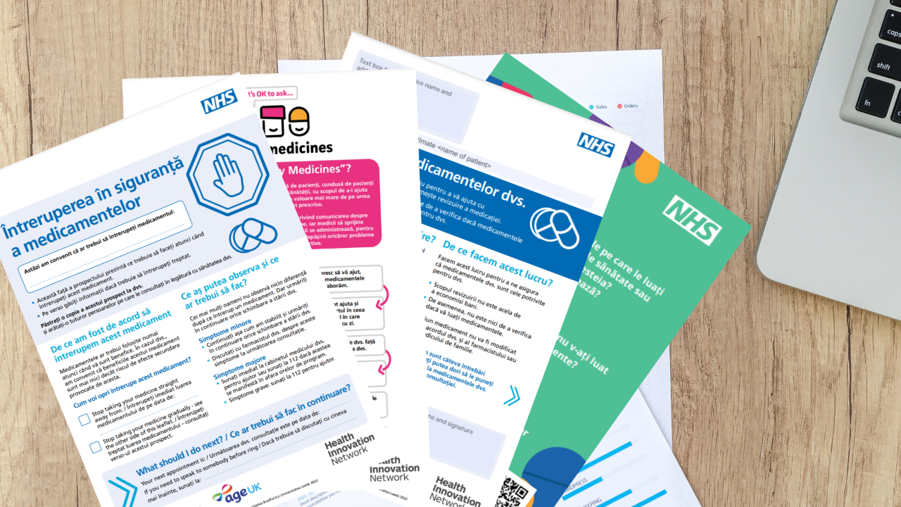
The Health Innovation Network have produced various resources in Romanian to support patients having a Structured Medication Review.
Standard versions:
Patient invitation letter
Safely stopping your medicine leaflet
Me and My Medicines Charter
Are Your Medicines Working? patient checklist
Are Your Medicines Working? symptom tracker
Easy read versions:
Patient invitation letter – easy read
Safely stopping your medicine leaflet – easy read
Me and My Medicines Charter – easy read
A new animation has also been created to help patients think about their medicines and to prepare for a Structured Medication Review which you can view here.

Slide 10

The Health Innovation Network have produced various resources in Somali to support patients having a Structured Medication Review.
Standard versions:
Patient invitation letter
Safely stopping your medicine leaflet
Me and My Medicines Charter
Are Your Medicines Working? patient checklist
Are Your Medicines Working? symptom tracker
Easy read versions:
Patient invitation letter – easy read
Safely stopping your medicine leaflet – easy read
Me and My Medicines Charter – easy read
A new animation has also been created to help patients think about their medicines and to prepare for a Structured Medication Review which you can view here.

Slide 11
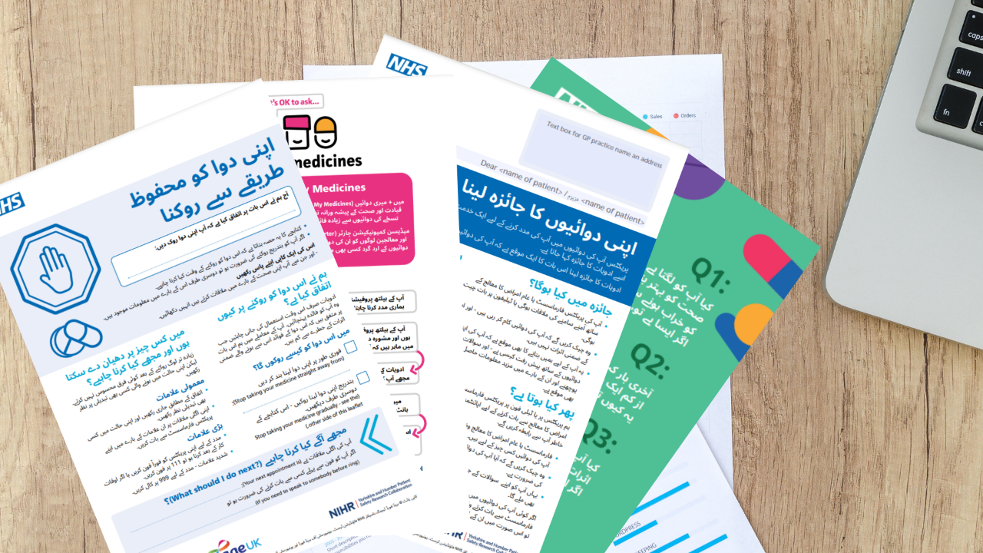
The Health Innovation Network have produced various resources in Urdu to support patients having a Structured Medication Review.
Standard versions:
Patient invitation letter
Safely stopping your medicine leaflet
Me and My Medicines Charter
Are Your Medicines Working? patient checklist
Are Your Medicines Working? symptom tracker
Easy read versions:
Patient invitation letter – easy read
Safely stopping your medicine leaflet – easy read
Me and My Medicines Charter – easy read
A new animation has also been created to help patients think about their medicines and to prepare for a Structured Medication Review which you can view here.

