Slide 1
Signs someone may be unwell and what should I do? (RESTORE2mini)
The physical deterioration and escalation tool for the care sector
Wessex Patient Safety Collaborative

Slide 2

Information for Presenters using this slide deck
These slides have been developed as a resource for people seeking to implement RESTORE2mini.
They may be used as a standalone training resource or in conjunction with the RESTORE2 “Rollout Handbook” (April 2020). The Handbook refers to the full version of RESTORE2 for Care Homes which includes references to the National Early Warning Score (NEWS2) in those settings.
RESTORE2mini is a Soft Signs based approach and does not include the use of NEWS2. NEWS2 and the full version of RESTORE2 are referenced in these slides to explain the development of the RESTORE2mini tool and to clarify the differences between the versions for staff who may be aware of both. Other versions of the RESTORE2mini tool have been adapted so that the language is more appropriate for the care setting and presenters may wish to adapt these slides in a similar way.
Some relevant “Managing Deterioration” videos are referenced on the relevant slides. The short 3 minute videos from Health Education England may be used as a teaching aid during a training session or referred to as an available resource for future use.
These slides may be adapted by presenters as long as the content of the tools themselves are not amended in any way. This includes NEWS2, RESTORE2, SBARD and any other tools referred to.
Some other resources are signposted via some relevant Wessex PSC webpages. Presenters may wish to adapt the slides to point to other sites as well as, or instead of, the Wessex PSC information.
We hope you find these resources helpful to your work. Constructive feedback is always welcome to improve our materials, comments to geoff.cooper@wessexahsn.net
Wessex PSC – 13/3/2021

Slide 3


Ask the person you support – how are you?
A Patient Safety Initiative co-produced by
West Hampshire CCG & Wessex Patient Safety Collaborative

Slide 4
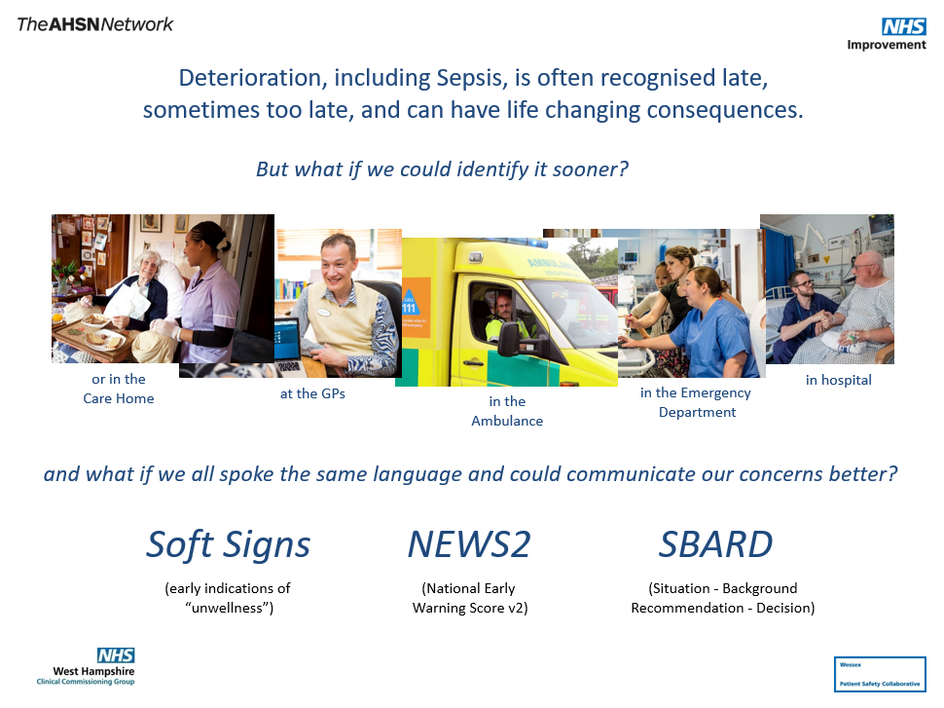


Slide 5
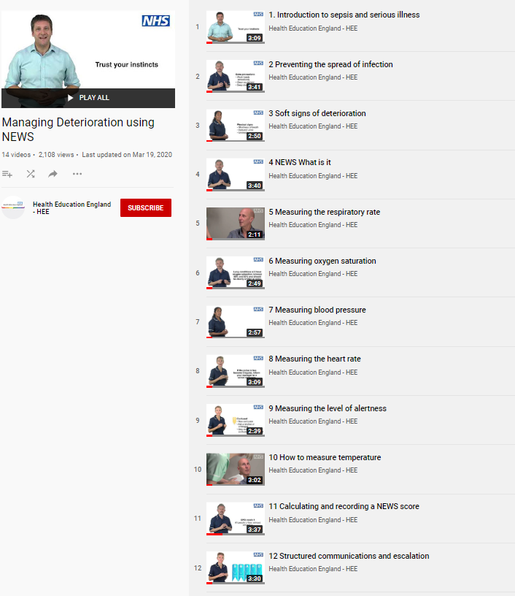
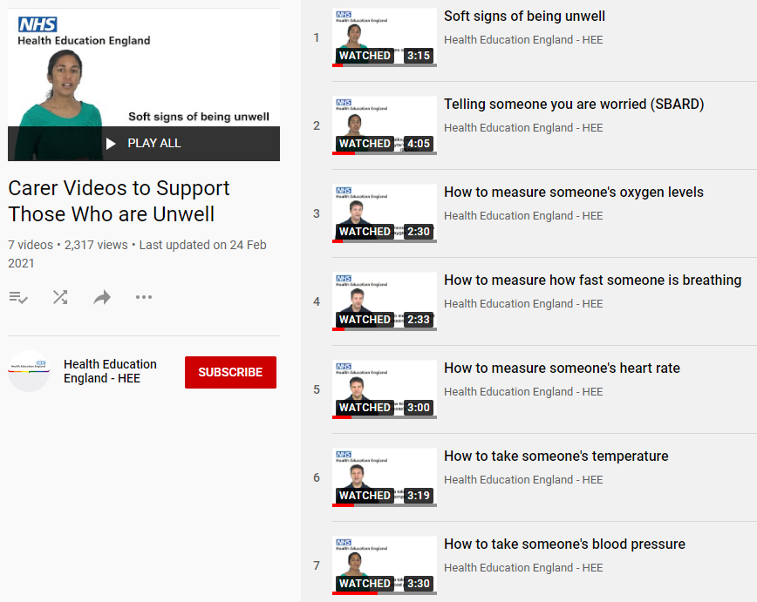

Additional Resources - Managing Deterioration Videos
Wessex AHSN and West of England AHSN have collaborated with West Hampshire CCG (RESTORE2) and Health Education England to produce a series of free videos and e-learning materials to support staff working in care homes to care for residents who are at risk of deterioration.
14 Managing Deterioration Videos can be accessed via: https://wessexahsn.org.uk/projects/358/care-home-training-resources and individual videos applicable to the use of RESTORE2mini are flagged below with a green tick ( ) and indicated on the relevant slides.
7 videos have been re-filmed specifically to support carers of people with a learning disability. These are shown in the list on the right.
✓
✓
✓
✓
✓
✓
✓
5

Slide 6
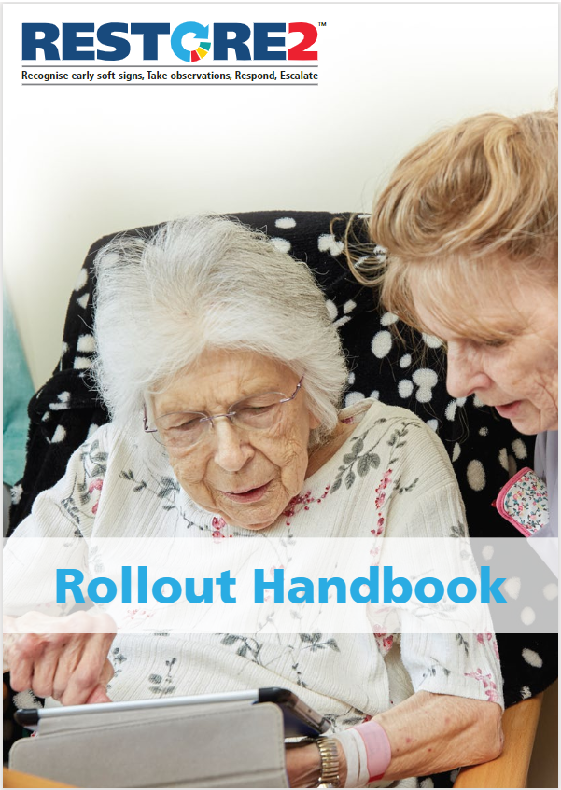
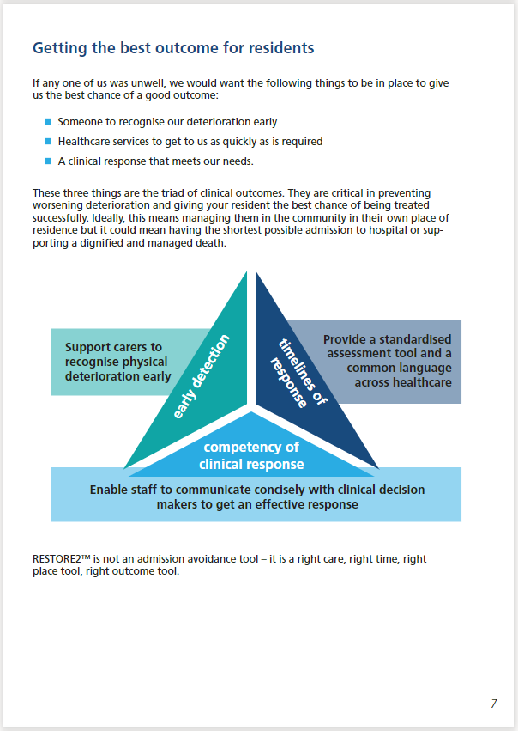
Additional Resources - Rollout Handbook
West Hampshire CCG have produced a Rollout Handbook for RESTORE2 to support staff working in care homes to care for residents who are at risk of deterioration. The handbook is available from https://westhampshireccg.nhs.uk/restore2/.
These training slides have been adapted for “Signs someone may be unwell and what should I do? (RESTORE2mini)”. NB: Some of the slides refer to “Care Homes” and “Residents” as they are based on the Rollout Handbook and/or refer to the full RESTORE2 version.

Slide 7

Firstly, a quick word about…

Slide 8
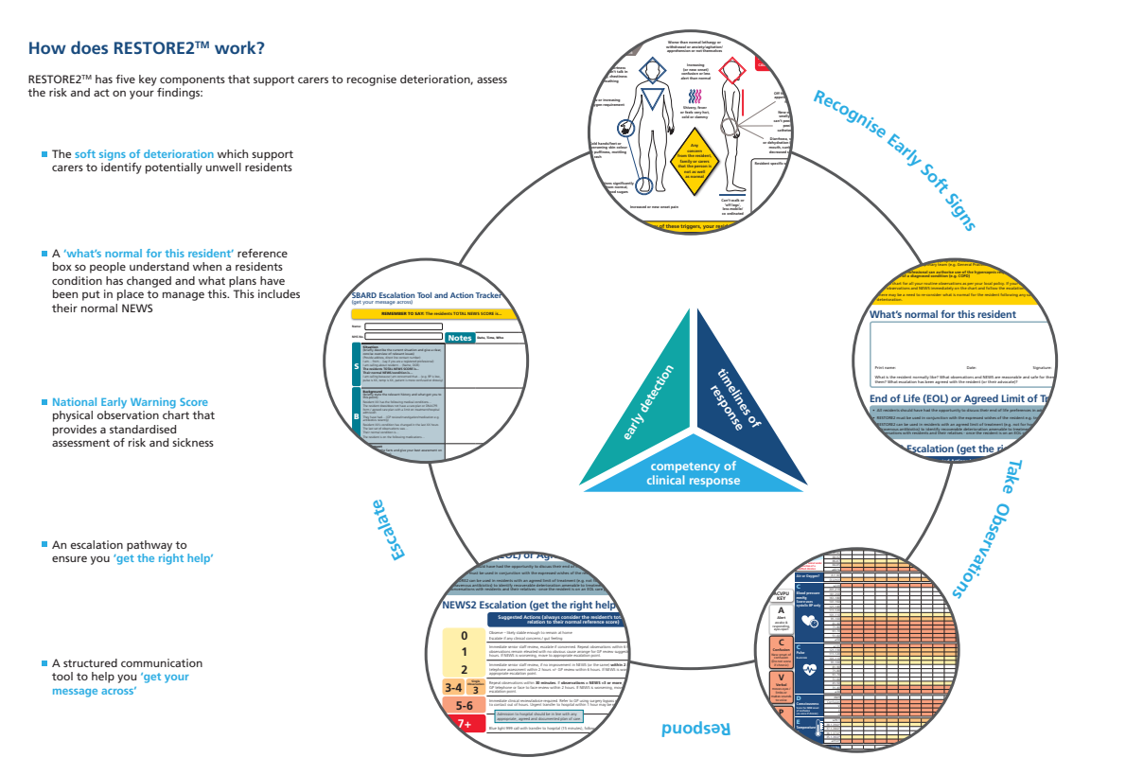
Soft Signs
Including advanced care plans (ACPs) and residents End of Life preferences
* Physical observations are also important to support Care Home “Virtual Wards” & video consultations by GPs
SBARD
Normal (EoL)
Including ACPs and any organisational policies for raising concerns.
Escalation
NEWS

Slide 9


Where does RESTORE2mini fit in?
RESTORE2mini focuses on using Soft Signs and SBARD
(plus recognising normal) to recognise deterioration and report concerns.
Soft Signs
SBARD
Normal (EoL)
Including ACPs and any organisational policies for raising concerns.
*NB: RESTORE2mini for Learning Disability uses the terminology “the person you support” rather than “Care Home” and “residents”
Escalation
NEWS

Slide 10
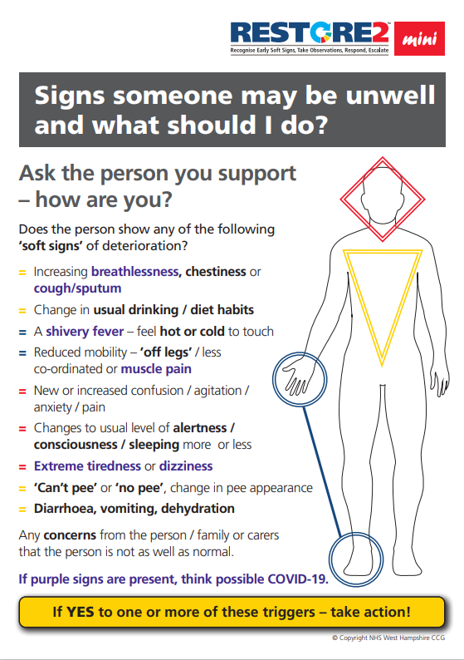
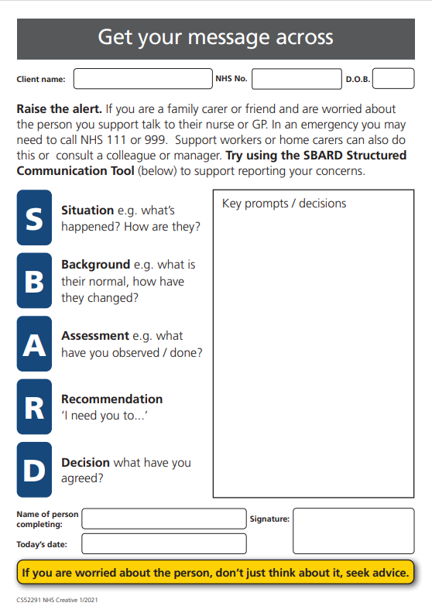
A Soft Signs approach to identifying Deterioration
With purple (possible Covid-19) Soft Signs

Slide 11
A Soft Signs approach to identifying Deterioration
Understanding Soft Signs
Recognising Normal

Slide 12



Understanding Soft Signs

Slide 13
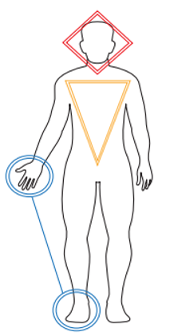
Using Soft Signs to Identify early indications of Physical Deterioration
Early signs of physical “unwellness” can be recognised intuitively by physical healthcare practitioners as evidenced by people saying “I know something is wrong, I just don’t know what”.
Even people without training, but who are familiar with someone’s usual behaviour and habits, can often sense a problem resulting in them reporting that the relative, person or child in their care “just isn’t themselves”.
There is some evidence to suggest that it is possible to identify physical deterioration before hard physiological signs are present with one study by Boockark et al finding that “Nursing assistants' documentation of signs of illness preceded chart documentation by an average of 5 days.”
Geoff Cooper, Wessex PSC Programme Lead for Deterioration, has written a paper exploring the understanding of Soft Signs in the literature and their application to Deterioration. This paper can be downloaded from the Wessex PSC website at: https://wessexahsn.org.uk/projects/357/using-soft-signs-to-identify-early-indications-of-physical-deterioration

Slide 14
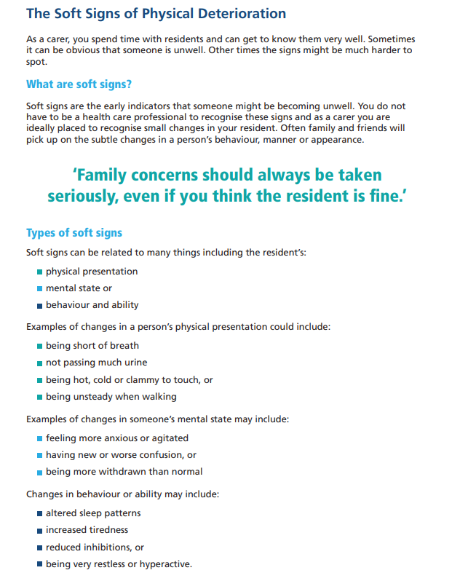
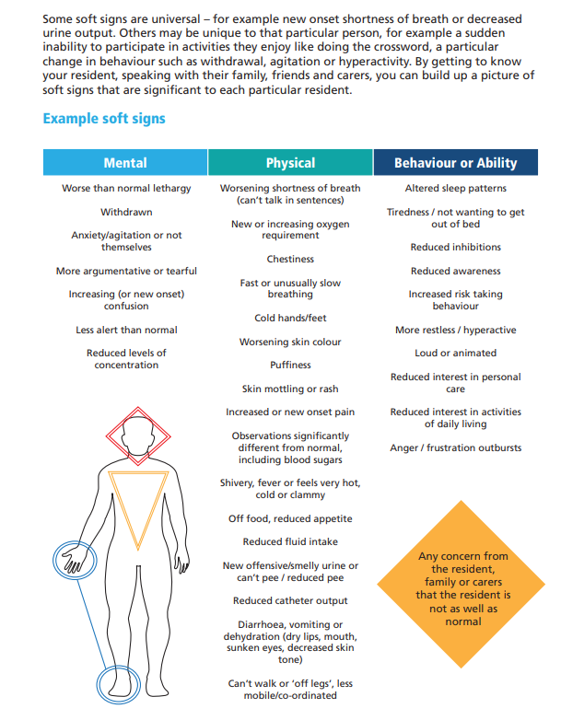

Slide 15
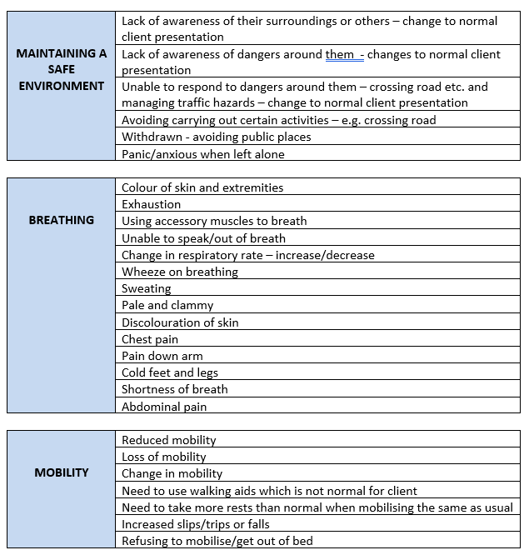


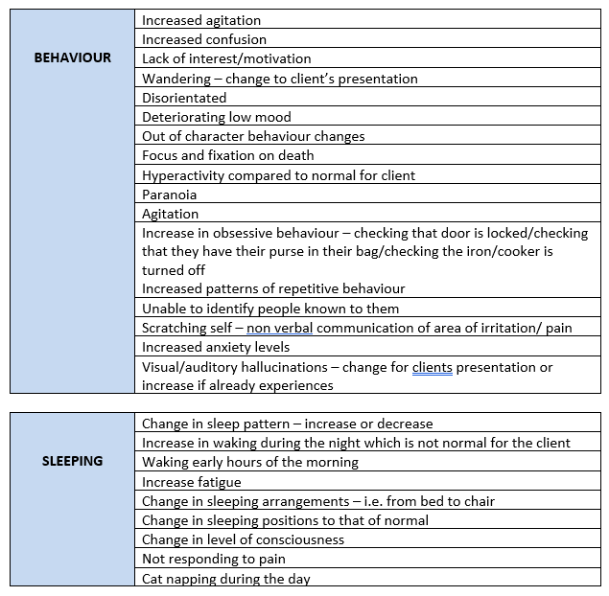
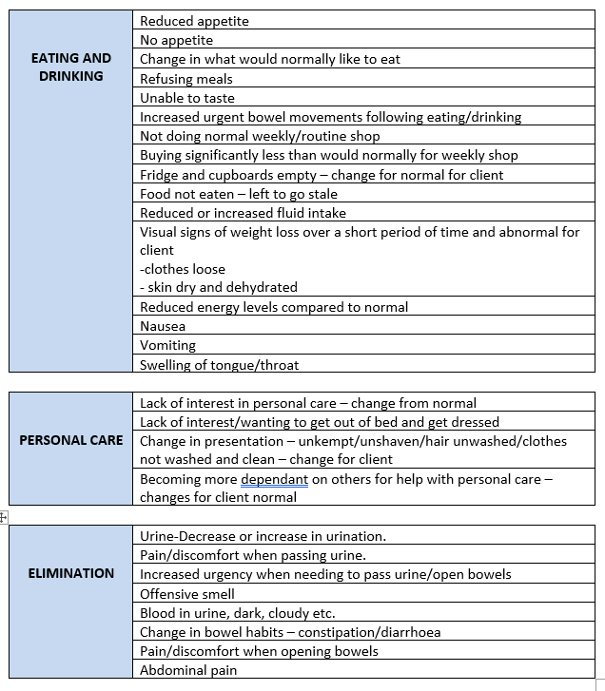
A taxonomy of Soft Sign indicators of deterioration

Slide 16
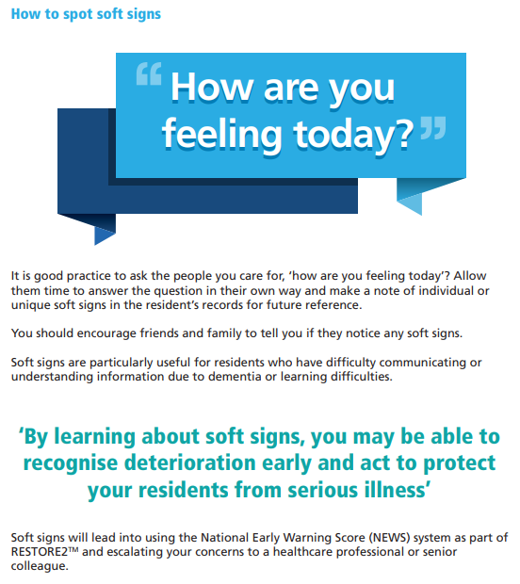
This slide is taken from the Rollout Workbook for Care Homes hence use of the term “resident”.
People working in other care sectors or non-residential care settings may prefer to use the terms client or “person you support” instead.

Slide 17
Recognising normal

Slide 18
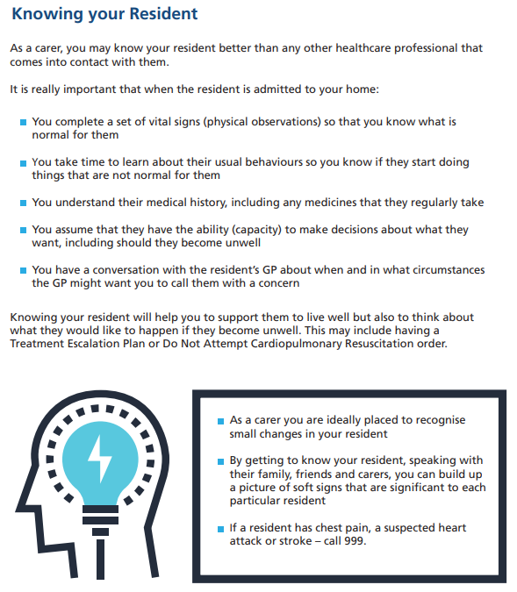
This slide is taken from the Rollout Workbook for Care Homes hence use of the term “resident”.
People working in other care sectors or non-residential care settings may prefer to use the terms client or “person you support” instead.

Slide 19
Treatment Escalation and Personal Care Plans
A Treatment Escalation Plan (TEP) or Personal Care Plan (PCP) include personal recommendations about an individual’s medical care and are made with the client and their caring team, and often with their family.
Other relevant information about someone’s personal care needs may also be found in:
A healthcare or hospital passport which is a document with information about the person with learning disabilities and their health needs. More at: https://www.nhs.uk/conditions/learning-disabilities/going-into-hospital/ and a template hospital passport at: https://www.mencap.org.uk/advice-and-support/health/health-guides
A Learning Disability Health Action Plan which is produced by a GP as part of a patient’s annual health check. A health action plan identifies the patient’s health needs, what will happen about them (including what the patient needs to do), who will help and when this will be reviewed. (More at: https://northlincolnshireccg.nhs.uk/learning-disability-health-action-plans/ )
A ‘My Future Wishes Plan’ which helps people with learning disabilities be involved in planning for their future care. (More at: https://www.nhft.nhs.uk/download.cfm?doc=docm93jijm4n13922 )
Living Well is a person-centred approach to supporting people to live with long term conditions and think about what they want for the end of their life. (More at: http://helensandersonassociates.co.uk/person-centred-practice/living-well/ )

Slide 20
A Soft Signs approach to identifying Deterioration
* Term for “home” tbc
Raising the Alert
Reporting Concerns / Using SBARD

Slide 21
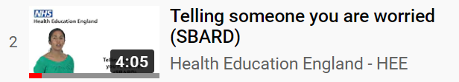
Raising the Alert
and
Reporting Concerns / Using SBARD

Slide 22
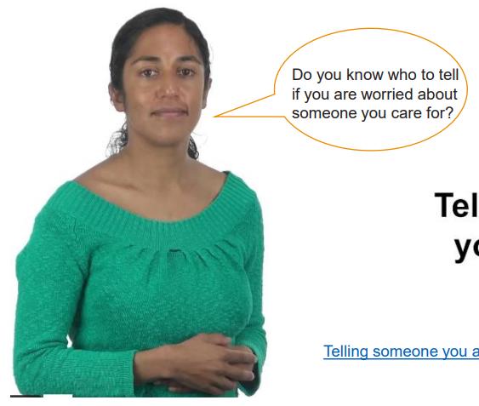
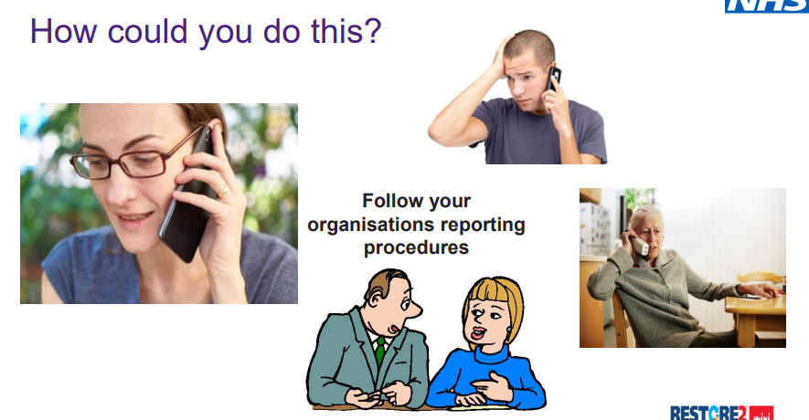
Telling someone you’re worried (SBARD)

Slide 23
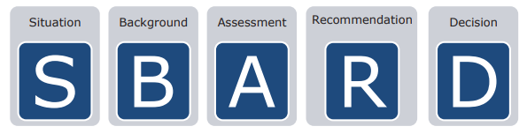
Getting your message across
Being able to communicate effectively is a critical skill for everyone working in healthcare. There is little point in recognising deterioration in someone you support if you are unable to communicate your concerns in a way that makes others take action to support you.
It can be difficult to communicate when you are under pressure or tired. It can be challenging communicating with so many different groups of people, including GPs, the ambulance service and community teams.
It is good practice to always try and plan your communication so you know what essential information you need to include. To assist you in getting your message across every time, RESTORE2 uses a Structured Communication Tool call SBARD. This is easy to use and helps information to be transferred accurately and safely between people.

Slide 24
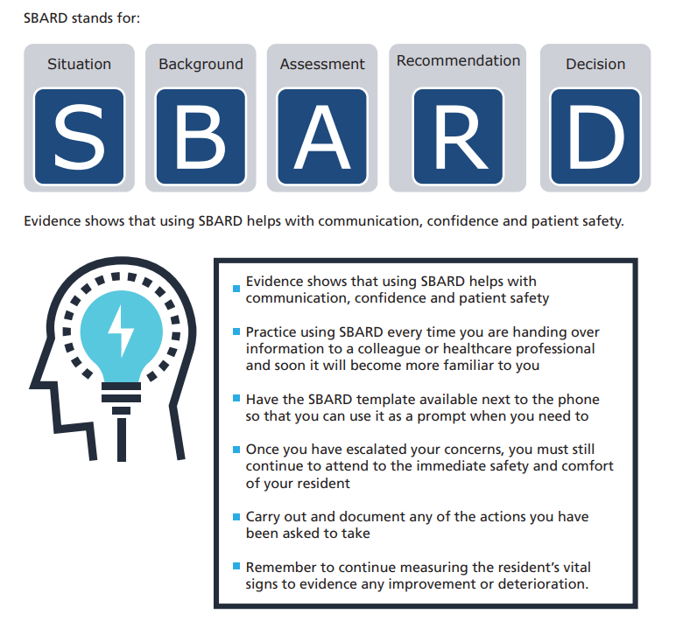
the person you support
their vital

Slide 25
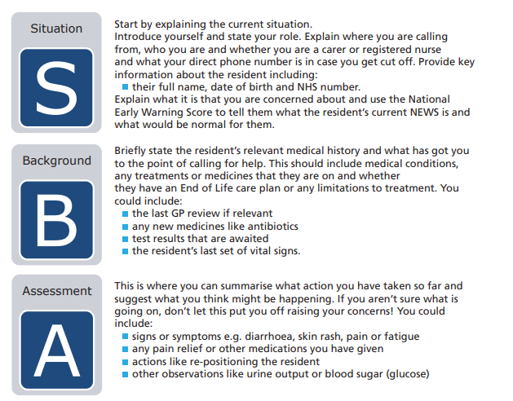
These slide are taken from the Rollout Workbook for Care Homes hence use of the term “resident”.
People working in other care sectors or non-residential care settings may prefer to use the terms client or “person you support” instead.

Slide 26
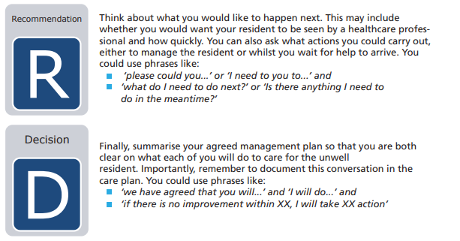
Think about what you would like to happen next.
This may include whether you would want your client to be seen by a healthcare professional and how quickly. You can also ask what actions you could carry out, either to manage the client or whilst you wait for help to arrive. You could use phrases like:
‘please could you...’ or ‘I need to you to...’ and
‘what do I need to do next?’ or ‘Is there anything I need to do in the meantime?’
Finally, summarise your agreed management plan so that you are both clear on what each of you will do to care for the unwell client.
Importantly, remember to document this conversation in the care plan. You could use phrases like:
‘we have agreed that you will...’ and ‘I will do...’ and
‘if there is no improvement within XX, I will take XX action’

Slide 27

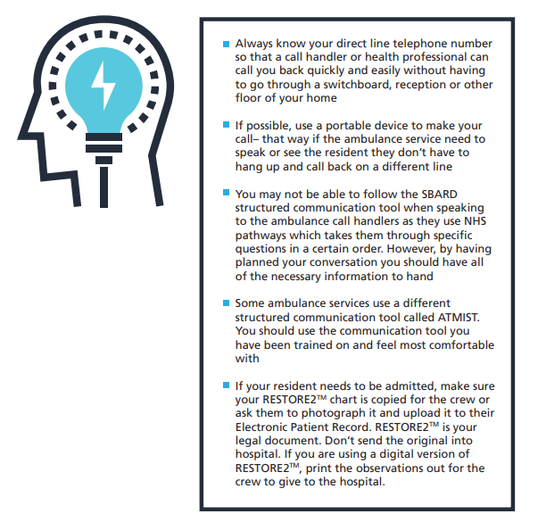
Calling for Help

Slide 28
Calling for Help

Slide 29
SBARD Example Scenario

Slide 30
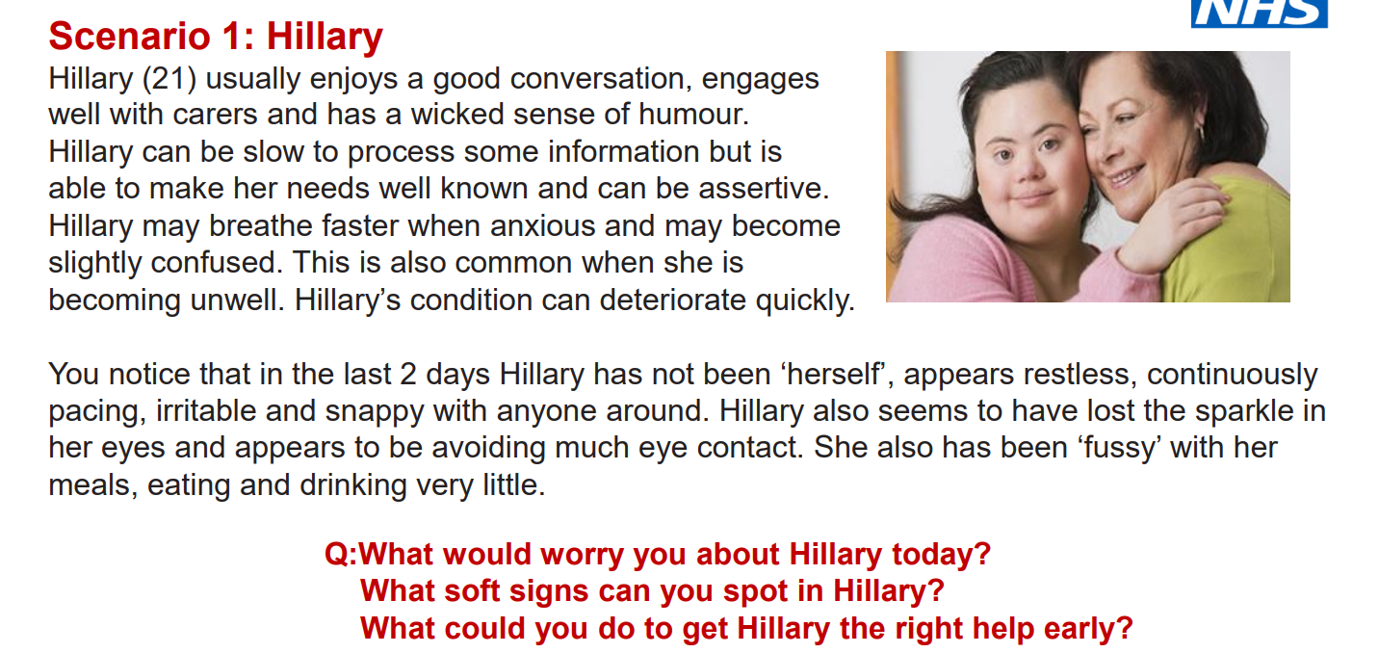
-

Slide 31
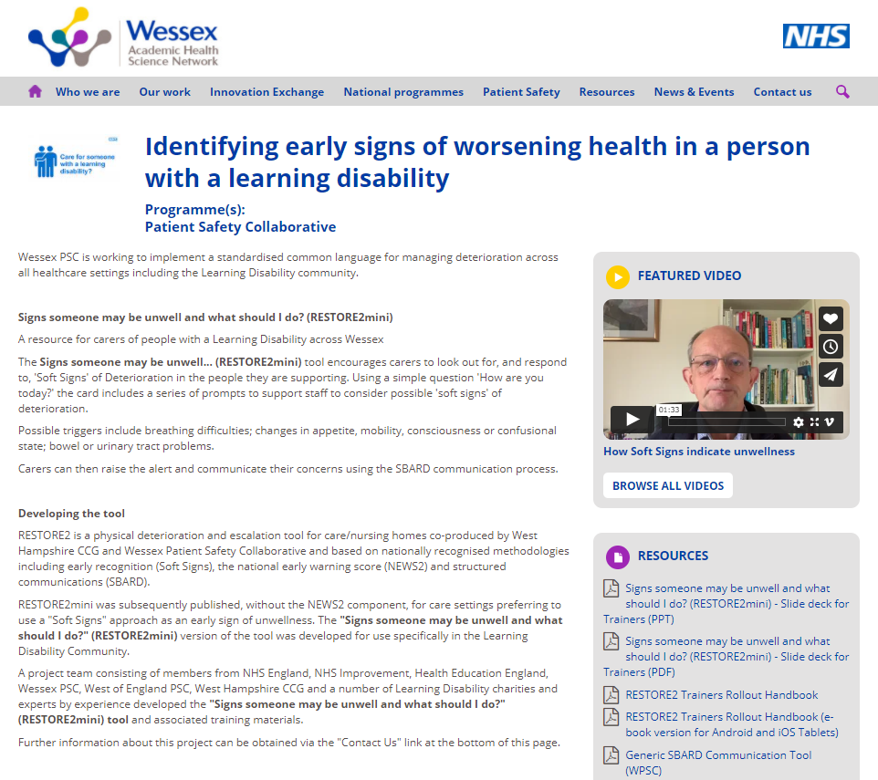
Additional information and resources
https://wessexahsn.org.uk/projects/401/identifying-early-signs-of-worsening-health-in-a-person-with-a-learning-disability

Slide 32
