Slide 1
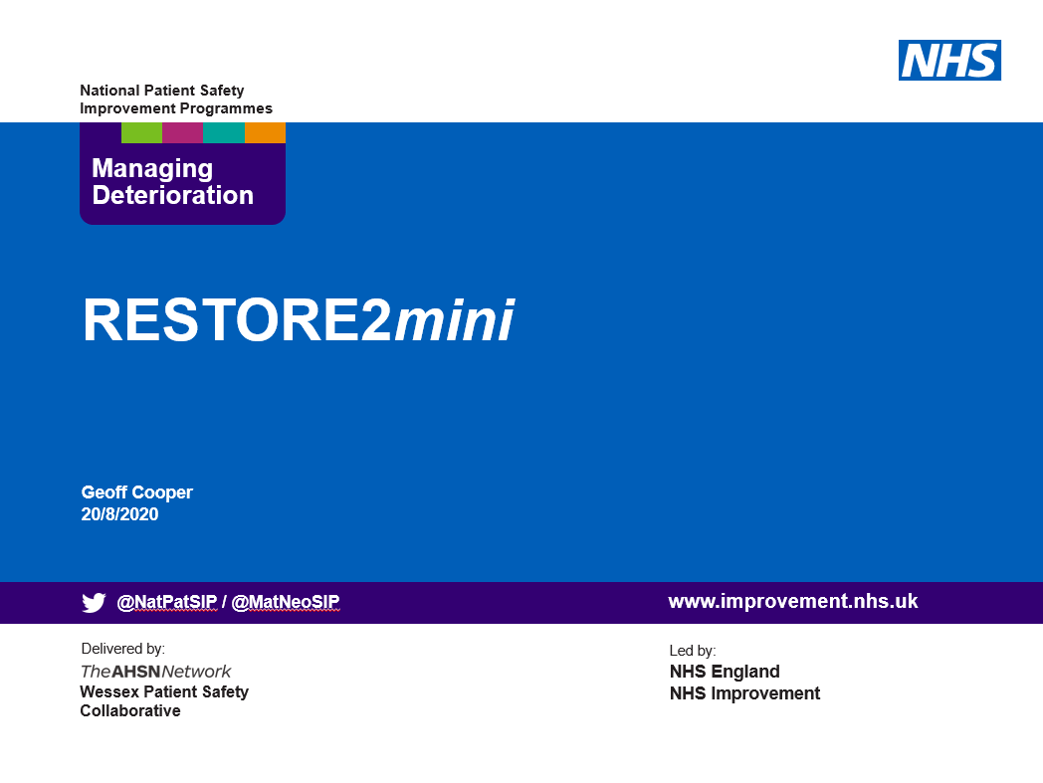

The physical deterioration and escalation tool for care/nursing homes

Slide 2

Information for Presenters using this slide deck
These slides have been developed as a resource for people seeking to implement RESTORE2.
They may be used as a standalone training resource or in conjunction with the RESTORE2 “Rollout Handbook” (April 2020).
The HEE “Managing Deterioration” videos are referenced on the relevant Slides. These short 3 minute videos may be used as a teaching aid during a training session or referred to as an available resource for future use.
Important note about the Case Studies at the end – You may want to re/move the slides with the answers on if you don’t want people seeing the answers too soon!
These slides may be adapted by presenters as long as the content of the tools themselves are not amended in any way. This includes NEWS2, RESTORE2, SBARD and any other tools referred to.
Some other Care Home resources are signposted via some relevant Wessex PSC webpages. Presenters may wish to adapt the slides to point to other sites as well as, or instead of, the Wessex PSC information.
We hope you find these resources helpful to your work. Constructive feedback is always welcome to improve our materials, comments to geoff.cooper@wessexahsn.net
Wessex PSC v5 - 18/11/2020

Slide 3

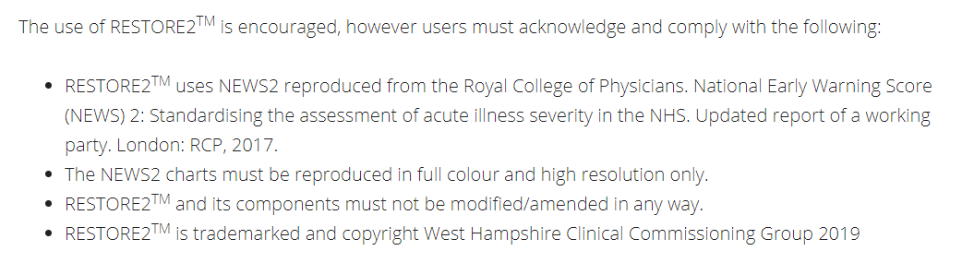
A Patient Safety Initiative co-produced by
West Hampshire CCG & Wessex Patient Safety Collaborative
RESTORE2 the physical deterioration and escalation tool for care/nursing homes.
It is designed to support homes and health professionals to:
Recognise when a resident may be deteriorating or at risk of physical deterioration
Act appropriately according to the resident’s care plan to protect and manage the resident
Obtain a complete set of physical observations to inform escalation and conversations with health professionals
Speak with the most appropriate health professional in a timely way to get the right support
Provide a concise escalation history to health professionals to support their professional decision making.

Slide 4
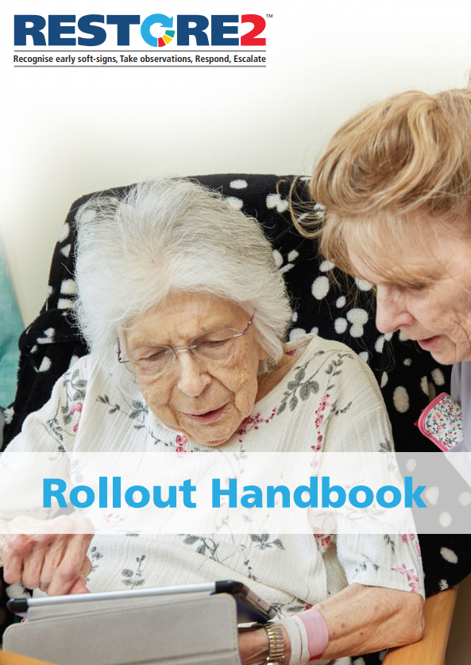
These slides can be used in conjunction with the RESTORE2 Rollout Handbook (April 2020)

Slide 5
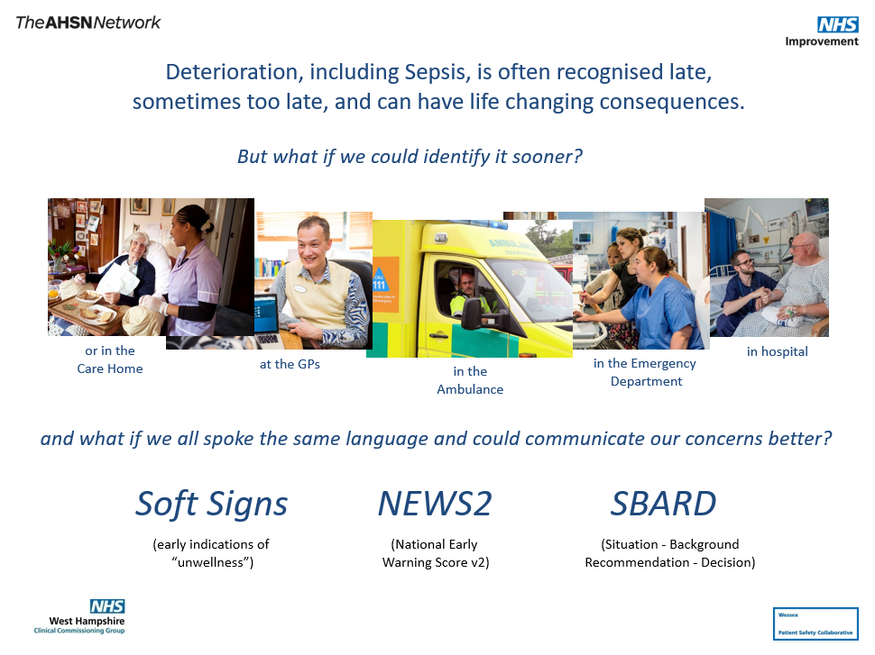

Slide 6
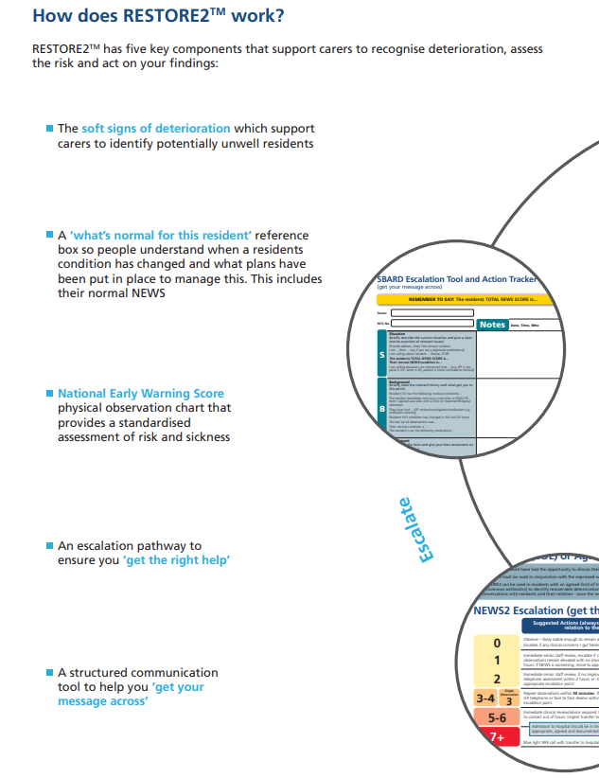
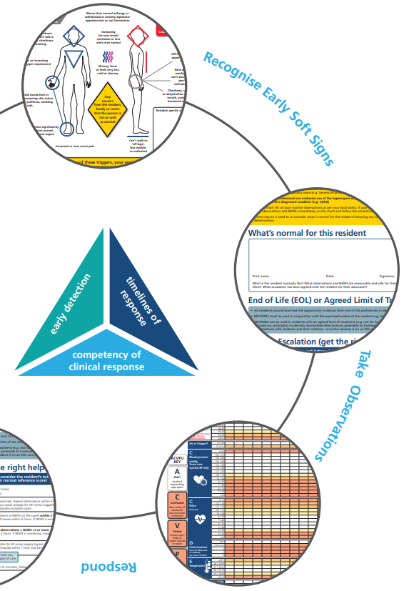

Slide 7
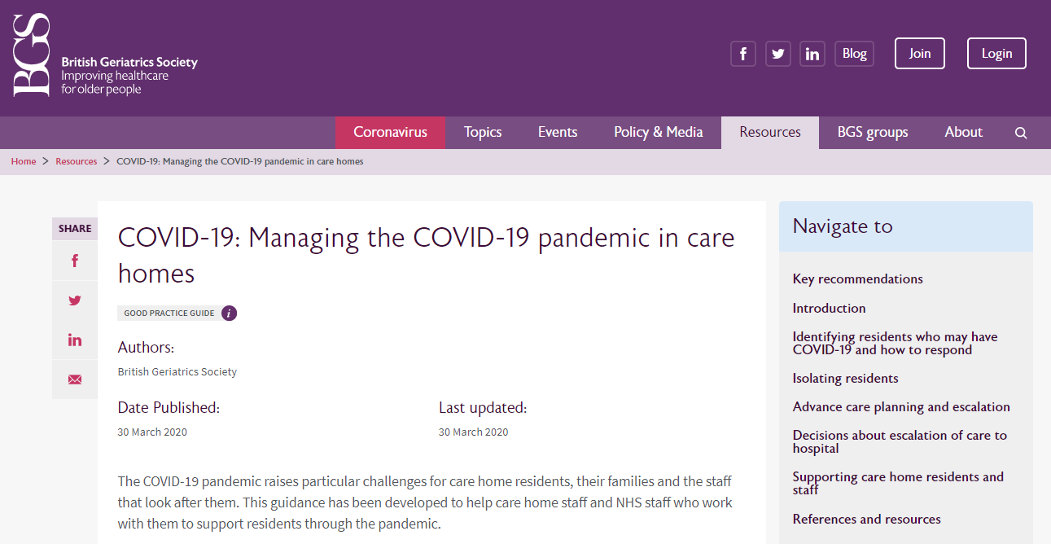

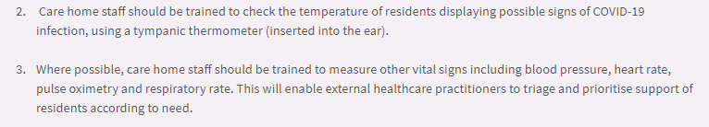
RESTORE2 has been recommended by the British Geriatric Society

Slide 8
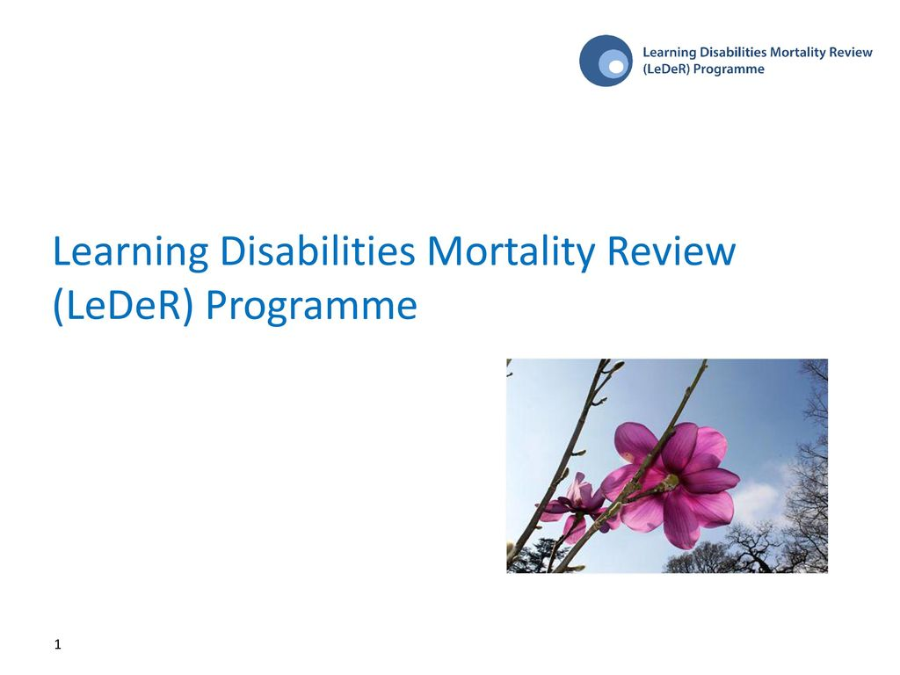
And by the LeDeR Programme

Slide 9
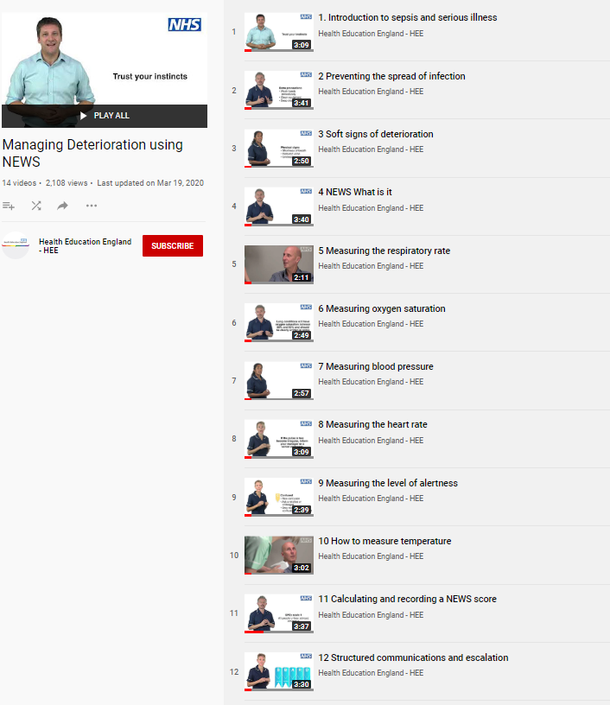
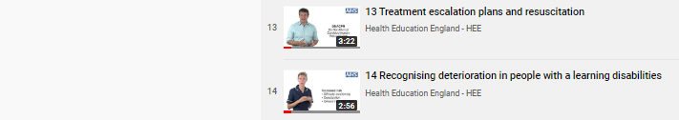
Additional Resources - Managing Deterioration Videos
Linking the Managing Deterioration Videos and RESTORE2
Spotting serious illness and sepsis
Some people are more at risk than others of becoming unwell very quickly and developing a serious illness such as sepsis. This is known as ‘deterioration’ and it is important that anyone who cares for individuals who are at risk of deterioration knows how to spot the signs, especially during the current COVID-19 outbreak.
Watch this film
Introduction to sepsis and serious illness
Soft Signs and What’s Normal
What to look out for when it is not appropriate to take measurements of a person’s vital signs.
The RESTORE2 mini tool is helpful in these situations.
A white paper from Geoff Cooper at Wessex AHSN looks at using soft signs to identify deterioration.
Watch these films
Preventing the spread of infection
Soft signs of deterioration
Recognising deterioration with a learning disability
Take Observations
The National Early Warning Score is used by GPs, ambulance services and acute hospital trusts.
RESTORE2 makes NEWS2 more accessible to care and nursing homes.
Watch these films
NEWS: What is it?
Measuring the respiratory rate
Measuring oxygen saturation
Measuring blood pressure
Measuring the heart rate
Measuring level of alertness
How to measure temperature
Calculating and recording a NEWS score
Escalate and Communicate
Effective communication is vital for safety critical messages between different healthcare staff
Watch these Films
Structured communication and escalation
Treatment escalation plans and resuscitation
Wessex AHSN and West of England AHSN have collaborated with West Hampshire CCG (RESTORE2) and Health Education England to produce a series of free videos and e-learning materials to support staff working in care homes to care for residents who are at risk of deterioration.
The full set of 14 Managing Deterioration Videos can be accessed via: https://wessexahsn.org.uk/projects/358/care-home-training-resources

Slide 10
Other Care Home Resources
Resources for Care Homes are being developed continuously
These Wessex PSC webpages will help signpost people to information, training resources and downloads for Care Homes
Enhanced Health in Care Homes: https://wessexahsn.org.uk/projects/304/enhanced-health-in-care-homes
Care Home Resources: https://wessexahsn.org.uk/projects/358/care-home-training-resources (with link to Videos)
RESTORE2: https://wessexahsn.org.uk/projects/329/restore2 (with link to West Hampshire CCG RESTORE2 webpage)
Using Soft Signs to Identify early indications of Physical Deterioration: https://wessexahsn.org.uk/projects/357/using-soft-signs-to-identify-early-indications-of-physical-deterioration
Other Wessex PSC Deterioration related webpages
Deterioration and NEWS: https://wessexahsn.org.uk/projects/116/deterioration-and-news
Safety Communications (inc. SBAR): https://wessexahsn.org.uk/projects/273/safety-communications-inc-sbar
Sepsis: https://wessexahsn.org.uk/projects/22/sepsis (with link to ICHP Suspicion of Sepsis Dashboard)
Other Wessex PSC Quality Improvement & Patient Engagement webpages
Quality Improvement Hub (QIHub): https://wessexahsn.org.uk/projects/127/quality-improvement-hub-qihub
Patient Engagement - Working with Patient Partners (Co-Design): https://wessexahsn.org.uk/projects/143/patient-engagement-working-with-patient-partners-co-design

Slide 11
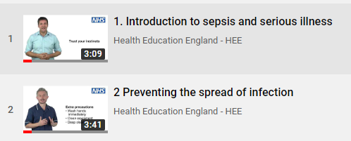

Introduction (Rollout Handbook Page 4)

Slide 12
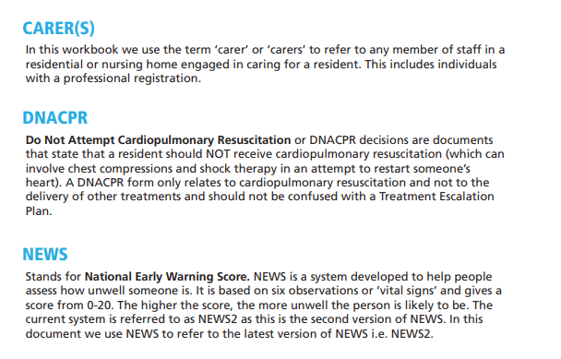
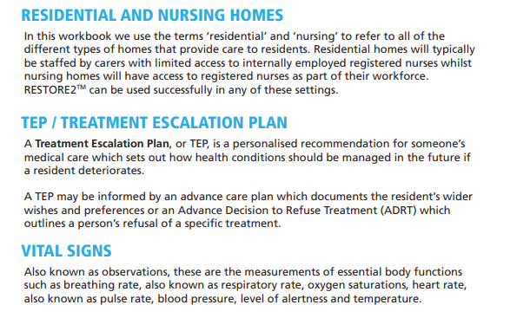
Understanding the terms used in these training resources

Slide 13
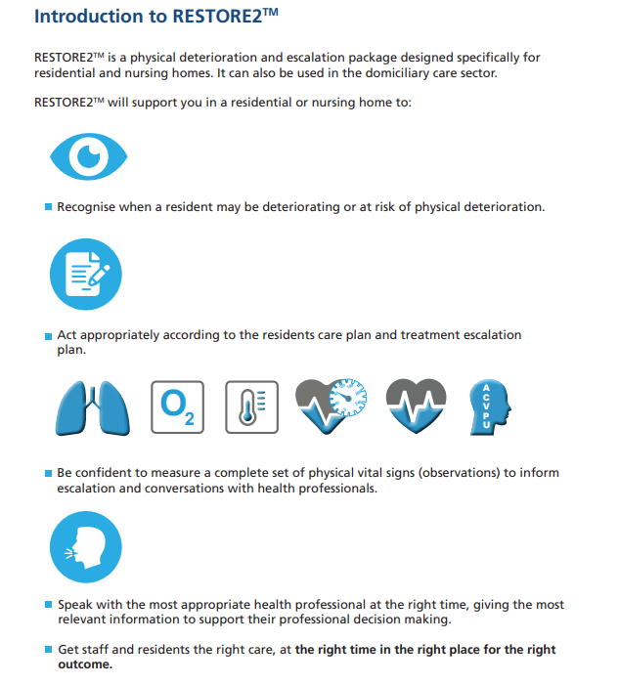

Slide 14
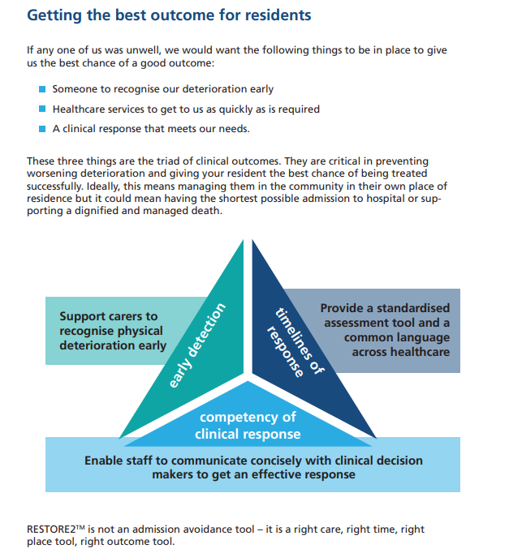

Slide 15
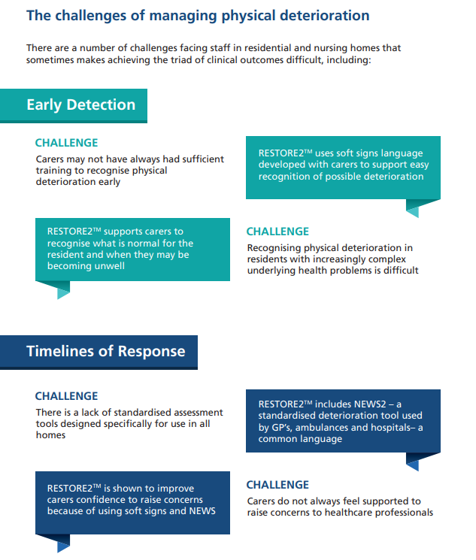
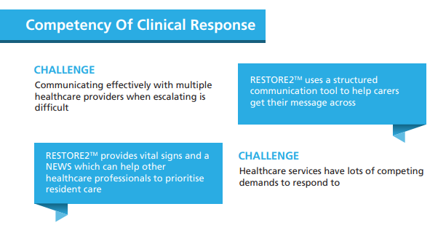

Slide 17
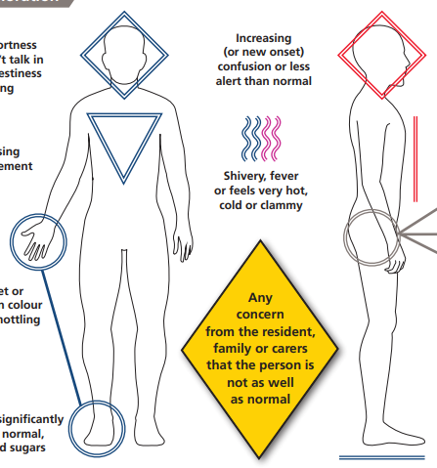
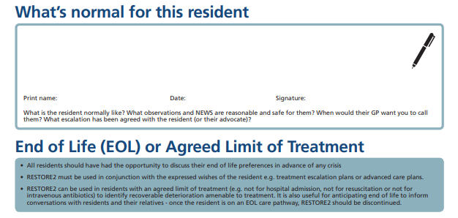
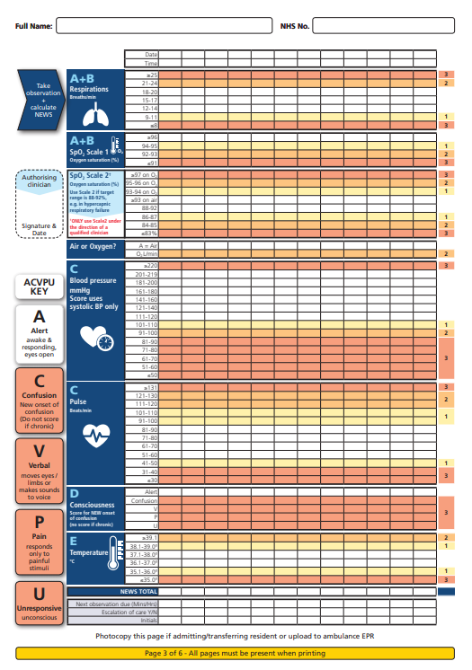
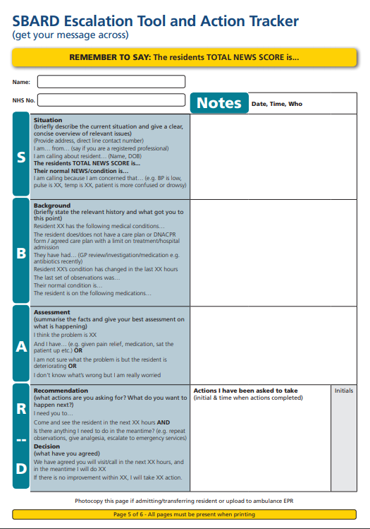
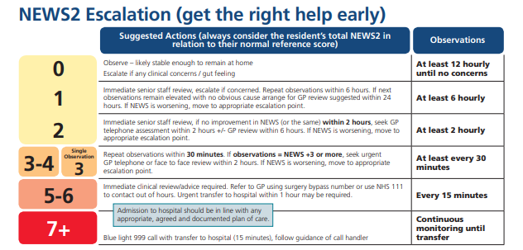
5 key elements of managing Deterioration
2 Knowing what’s normal (including EoL preferences)
1 Early Detection (Soft Signs)
4 Knowing what to do next
3 Understanding how unwell they are (NEWS2)
5 Communicating your concerns

Slide 18


Soft Signs (Rollout Handbook Page 12)

Slide 19
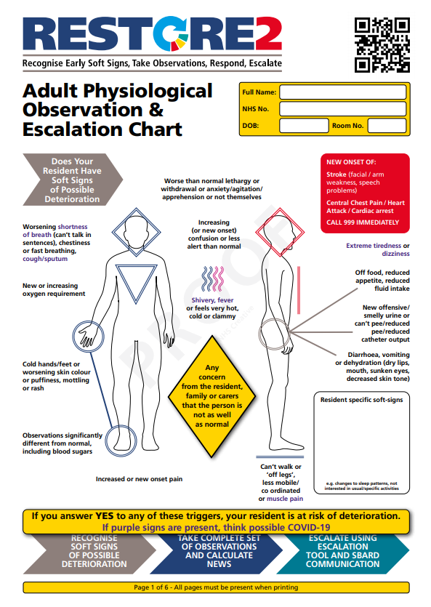
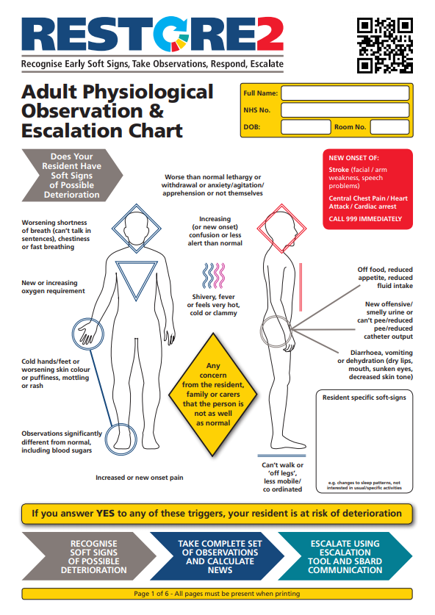
Check you have the latest version…
From: https://westhampshireccg.nhs.uk/restore2/
With purple (possible Covid-19) Soft Signs

Slide 20
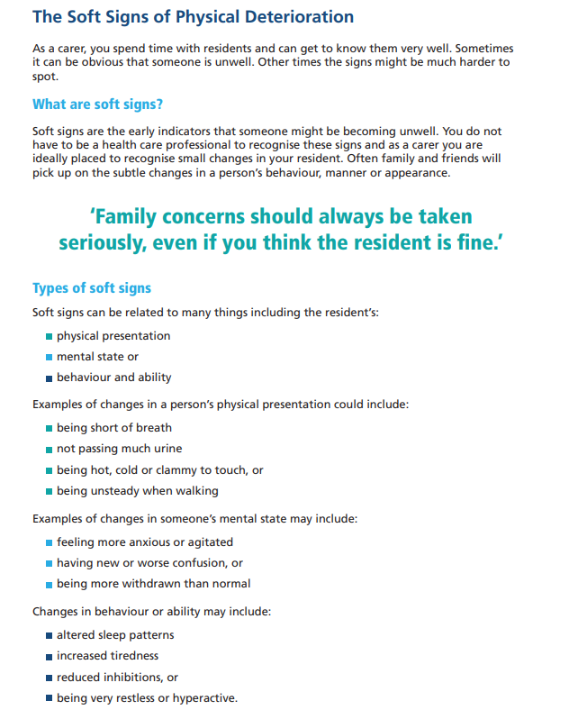
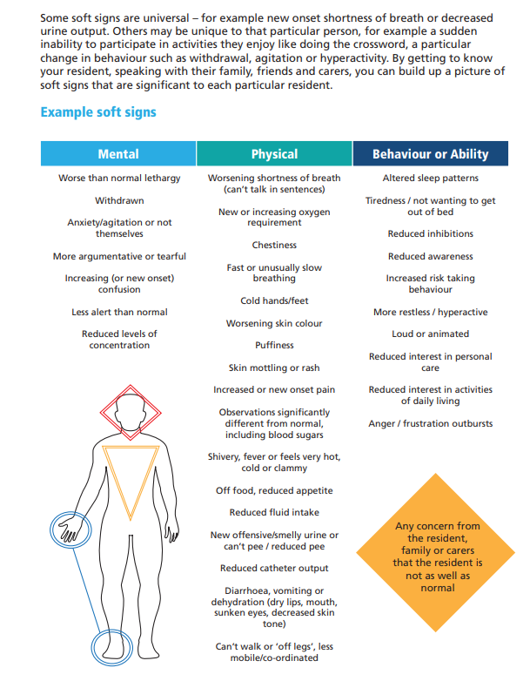

Slide 21
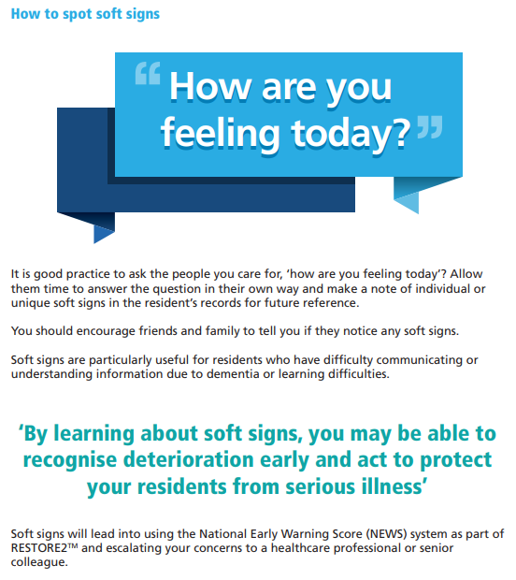

Slide 22
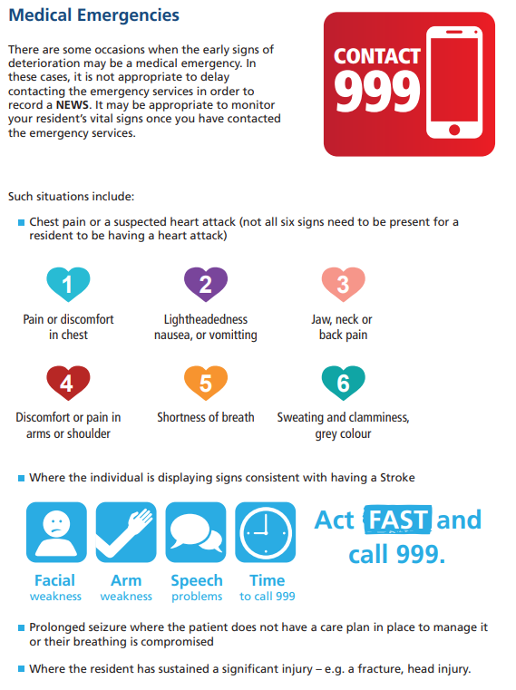

Slide 23
What’s normal (Rollout Handbook Page 16)

Slide 24
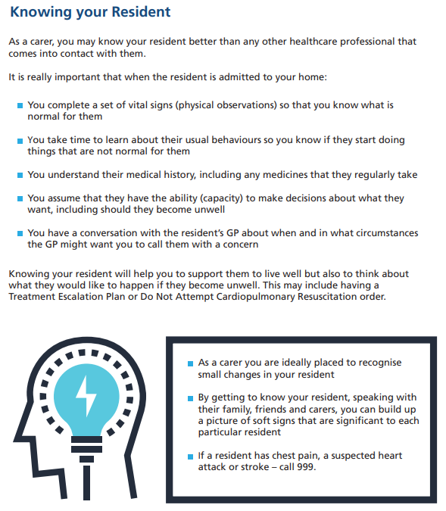

Slide 25
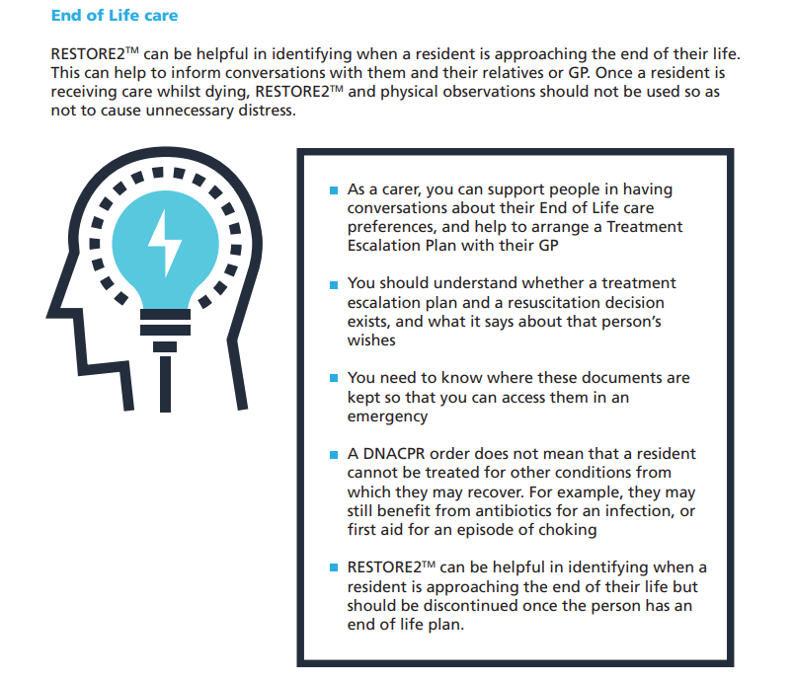

Slide 26
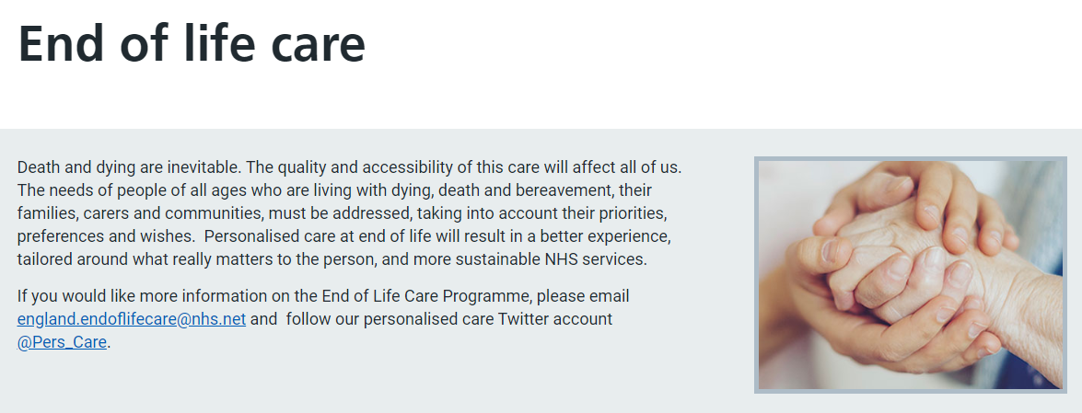


Slide 27
Treatment Escalation Plans and Resuscitation
Knowing your resident will help you to support them to live well but also to think about what they would like to happen if they become unwell...
When a resident you are caring for becomes unwell, there are different options for looking after them. If possible and safe, most residents would prefer to be treated in their own home. For some residents it will be appropriate to call the GP or 999 to arrange admission into hospital.
For some people, going into hospital is not appropriate or in their best interests. This can be for a number of reasons. Often, people who know they are approaching the end of their life may have decided that they want to die in their home and not in hospital if possible.
For others, perhaps where a specific illness or event has happened (for example a serious stroke) they may have previously expressed a wish to be looked after by people that know them in a way that maintains their dignity.
There are helpful documents available that support residents to have a say in their care prior to when they become unwell. These include Treatment Escalation Plans (TEPS) and Do Not Attempt Cardiopulmonary Resuscitation (DNACPR) documents.

Slide 28
Treatment Escalation Plans
A Treatment Escalation Plan, or TEP, is a personalised recommendation for someone’s medical care. It is for use in an emergency situation as a reference and communicates the level of intervention or de-escalation in the resident’s clinical management.
A Treatment Escalation Plan is made with the resident and their caring team, and often with their family. It is ideally made when they are well and can say what they would want to happen.
If your resident does not have the ability (capacity) to make decisions around what they would want to happen if they became unwell, a suitably trained person should undertake a capacity assessment that is time and decision specific – for example...if you developed a chest infection and oral antibiotics were not working, would you want to go into hospital for intravenous treatment?
If the person lacks capacity to make this decision then a decision in their best interests, involving the residents GP, close family and home staff can be made and documented.
The plan should include details about where the person wishes to be cared for and what treatments they would or would not want. This can include medication, surgery, intravenous antibiotics, or help with breathing. If your resident does not have a Treatment Escalation Plan you should assume they are for full treatment and intervention.

Slide 29
Resuscitation
Cardiopulmonary resuscitation can involve chest compressions and defibrillation (heart shock therapy) in an attempt to restart someone’s heart. Resuscitation is more likely to be successful in someone who is ft and well, than in someone who is frail with medical problems.
Do Not Attempt Cardiopulmonary Resuscitation or DNACPR decisions may be included in a Treatment Escalation Plan or be documented separately. They advise emergency teams like the ambulance service on whether they should or should not attempt resuscitation.
Even if a resident has a DNACPR in place, this does not mean that they cannot be treated for other conditions. For example, they may still benefit from antibiotics for an infection, or first aid for an episode of choking.

Slide 30
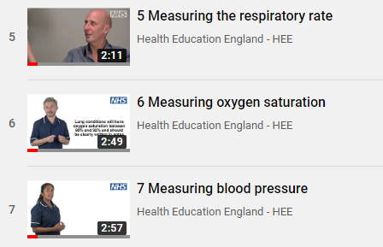
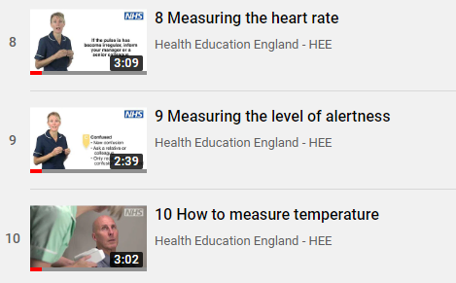

Taking Observations (Rollout Handbook Page 19)

Slide 31
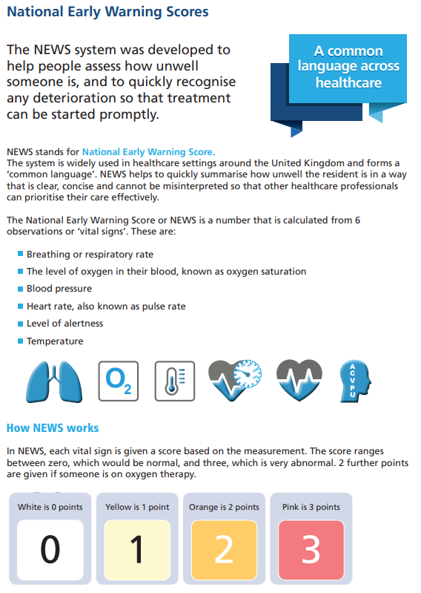
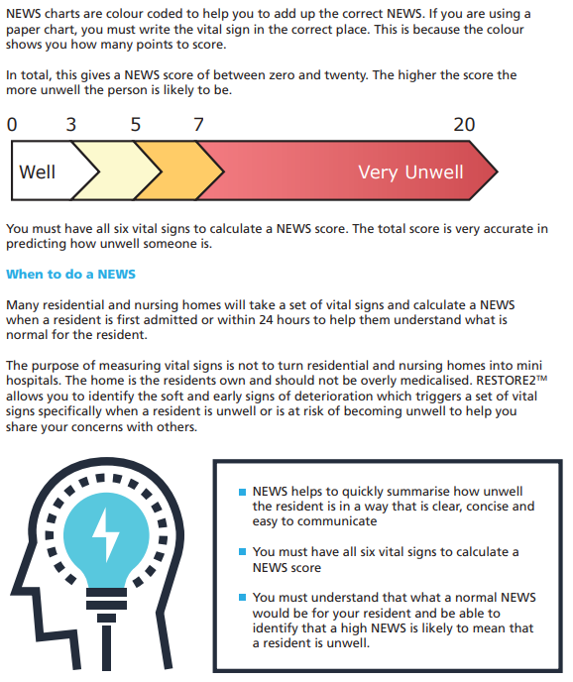

Slide 32
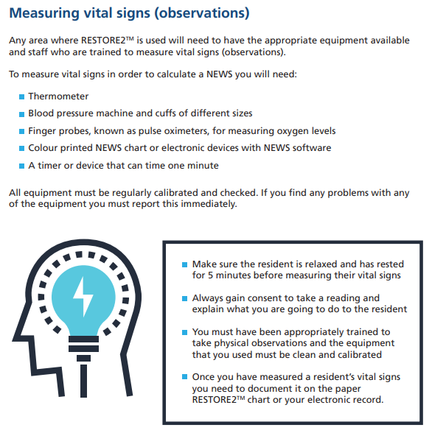

Slide 33
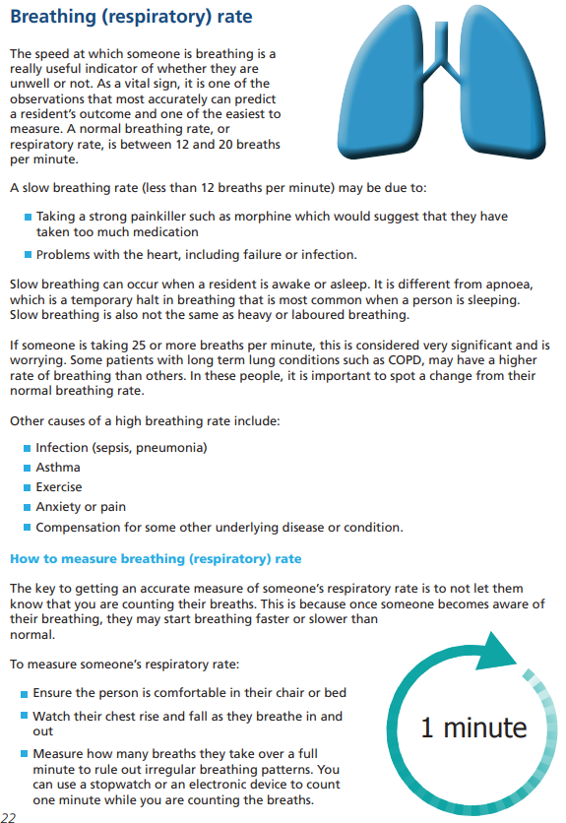
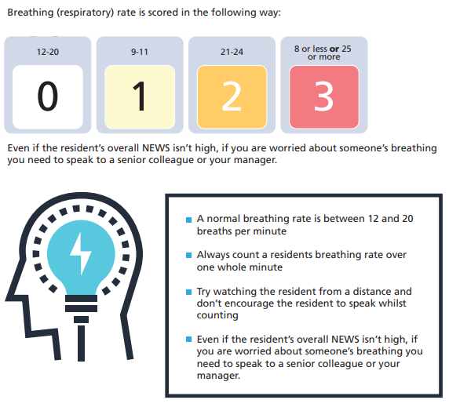

Slide 34
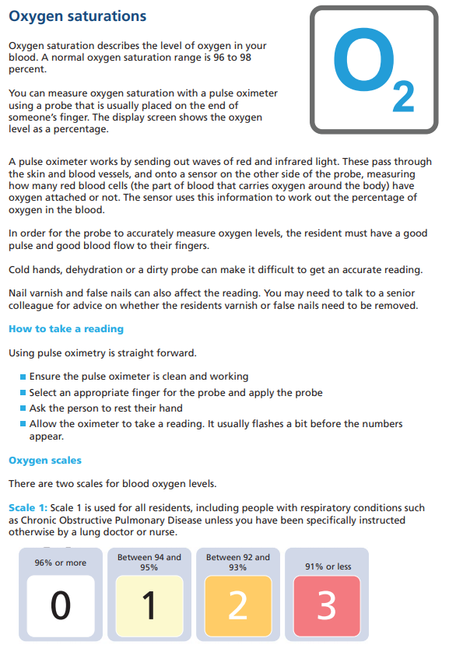
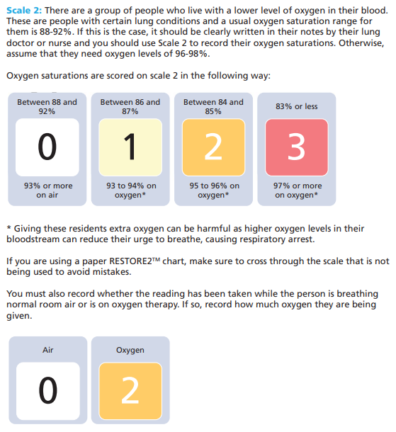

Slide 35
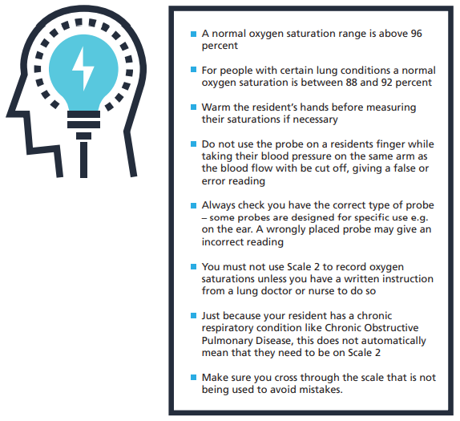

Slide 36
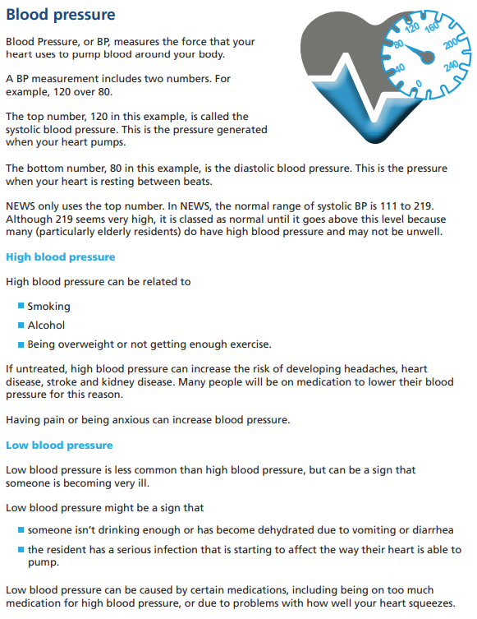
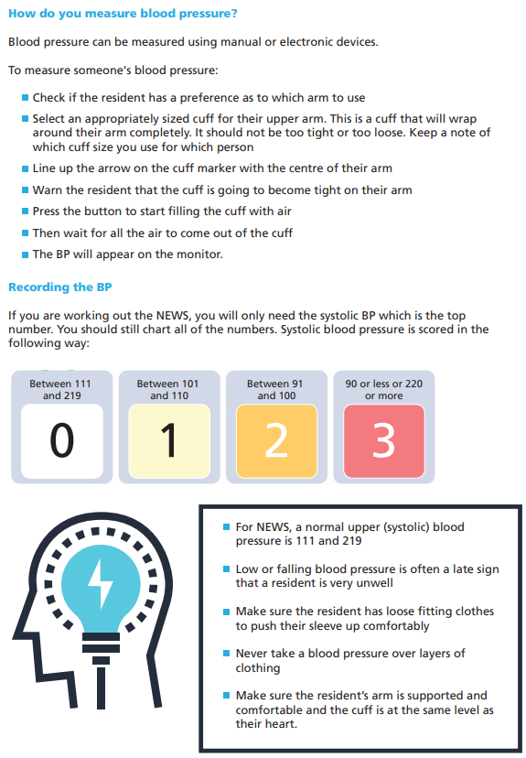

Slide 37
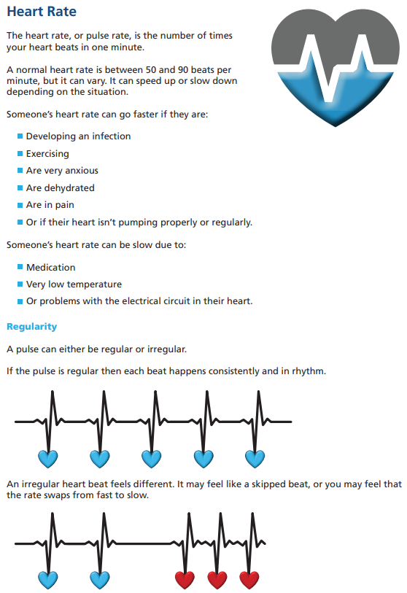
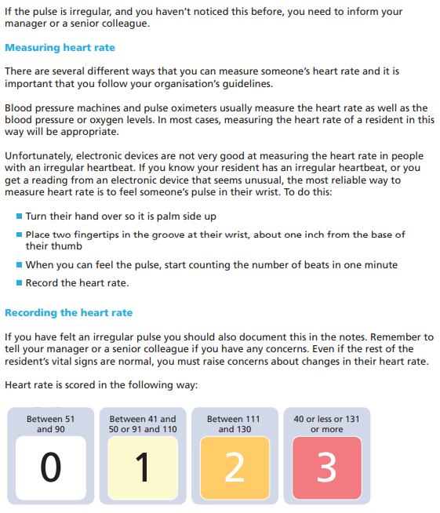
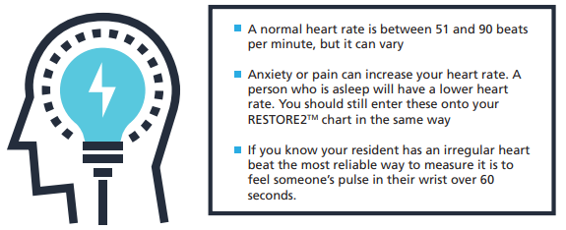

Slide 38
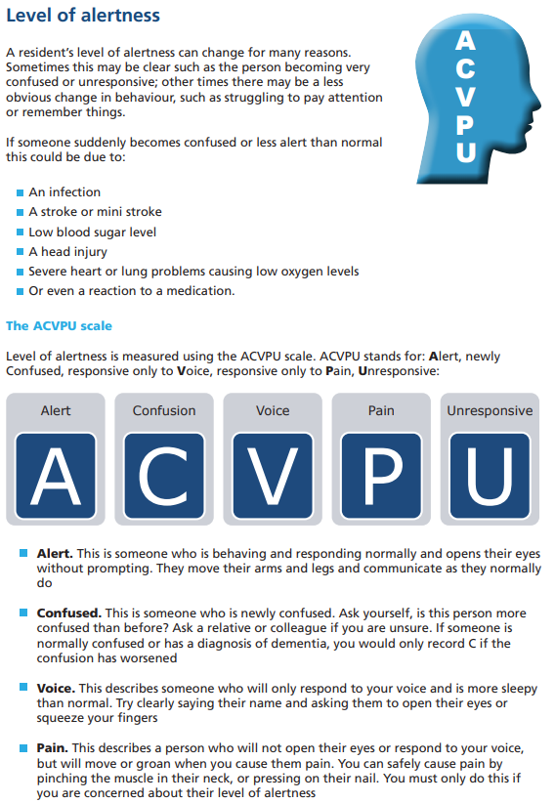
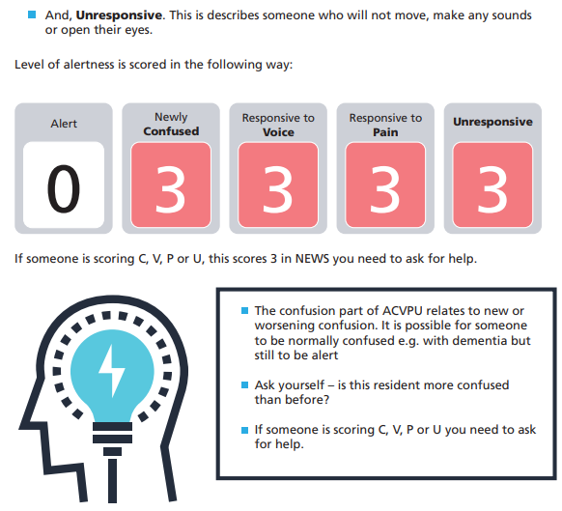

Slide 39
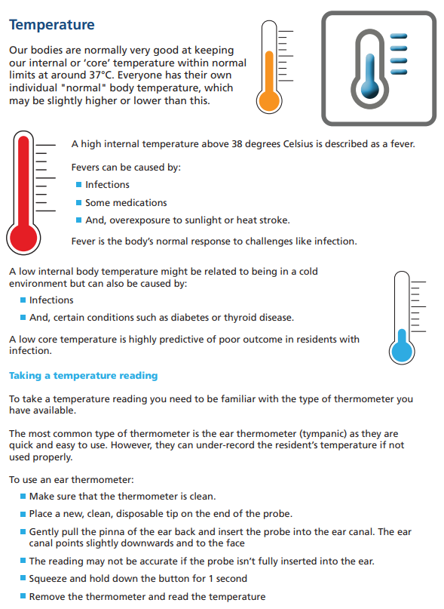


Slide 40



Slide 41

Escalation (Rollout Handbook Page 38)

Slide 42



Slide 43

Communication (Rollout Handbook Page 40)

Slide 44

Raising the Alert
Follow your organisations reporting procedures

Slide 45

Getting your message across
Being able to communicate effectively is a critical skill for everyone working with residents. There is little point in recognising deterioration in a resident if you are unable to communicate your concerns in a way that makes others take action to support you to manage your resident.
It can be difficult to communicate when you are under pressure or tired. It can be challenging communicating with so many different groups of people, including GPs, the ambulance service and community teams.
It is good practice to always try and plan your communication so you know what essential information you need to include. To assist you in getting your message across every time, RESTORE2 uses a Structured Communication Tool call SBARD. This is easy to use and helps information to be transferred accurately and safely between people.

Slide 46


Slide 47


Slide 48


Slide 49


Slide 50
Scenarios (Rollout Handbook Page 43)

Slide 51


Slide 52



Slide 53



Question 1 (Answer provided as example)
Question 2

Slide 54



Question 3
Question 4
Question 5
Question 6

Slide 55


Complete the Situation, Background, Assessment and Recommendation sections of the SBARD.

Slide 56
SBARD Example Scenario
Situation
I am “name” calling from Sunny Hollow Residential Home. I am a carer. My direct line / mobile number is 01276 123 4567.
I am calling about Simon, an 81 year old resident who appears unwell today. I am concerned that he is chesty with a higher than normal breathing rate and more confused than usual.
Background
Simon has dementia. He always recognises his daughter but struggled to recognise her today and thought that she was his mother.
Simon has a DNACPR in place but is for full treatment of any reversible illness, including hospital admission. He gets recurrent chest infections. He is currently on a blood pressure medication only. He does have antibiotics in the home.
He has deteriorated in the last XX hours his temperature is 37.8°C and his breathing rate is 24 breaths per minute.
Assessment
I think he has a chest infection. I have sat him up.
Recommendation
Please could you come and see him in the next hour. I will repeat his observations in 15 minutes. Would you like me to start his antibiotics?
Decision
Thank you, we have agreed that you will visit in the next 2 hours. In the meantime we will start his antibiotics and encourage him to take more fluids.

Slide 57
Scenarios (Rollout Handbook Page 47)
Plot Spoiler – Answers Shown

Slide 58


Slide 60
0
Correct answers: NEWS calculations
Q2 = zero (0)
Q3 = eight (8) because of Scale 2
Q4 = one (1) because of Scale 2
Q5 = three (3)
Q6 = nine (9)
8
1
3
9

Slide 61


Slide 62



Optional Competency Statement
Individual competency assessment is not a mandatory part of the RESTORE2 process
but a suggested template is included as an example for anyone considering adopting this approach.

Slide 63


Some “Top Tips” from West Hampshire CCG
These tips are offered as helpful advice not instruction. Full details of West Hampshire CCGs Implementation & Audit process referred to can be found on the West Hampshire CCG website (via: https://wessexahsn.org.uk/projects/329/restore2 ).

Slide 64

Some “Top Tips” from West Hampshire CCG
These tips are offered as helpful advice not instruction. Full details of West Hampshire CCGs Implementation & Audit process referred to can be found on the West Hampshire CCG website (via: https://wessexahsn.org.uk/projects/329/restore2 ).

Slide 65


